Slide 4
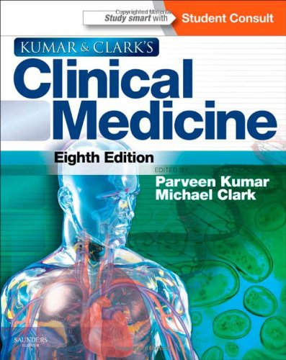

Slide 5
319121 616(075.8) C91 Clinical Medicine / ed. by Parveen Kumar, Michael Clark. - 8th ed. - Edinburg [etc.] : Elsevier Saunders, 2012. - XXIII, [2], 1286 p. : il.
Kumar and Clark's Clinical Medicine is known, respected and admired by medical students, doctors and health professionals throughout the world. It provides in one volume a comprehensive and authoritative source of information on the management and treatment of medical problems. Clarity of writing, a hallmark of Kumar and Clark, has been combined with a colourful and attractive presentation and a companion website to produce a complete resource of medical information. Kumar and Clark is now regarded as the one book that every aspiring and qualified doctor should own.

Slide 6
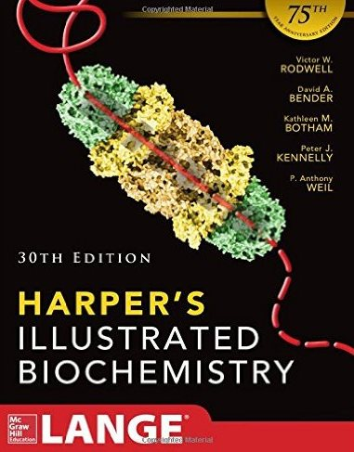

Slide 7
328669 577.1(075.8) H29 Harper's illustrated biochemistry / Victor W. Rodwell [et al.]. - 30th ed., international ed. - New York [etc.] : McGraw-Hill Education, 2015. - XII, 817 p. : il.
The Thirtieth Edition of Harper’s Illustrated Biochemistry combines outstanding full-color illustrations with authoritative integrated coverage of biochemical disease and clinical information. Using brevity and numerous medically relevant examples, Harper's presents a clear, succinct review of the fundamentals of biochemistry that every student must understand in order to succeed in medical school.
All fifty-eight chapters emphasize the medical relevance of biochemistry.

Slide 8
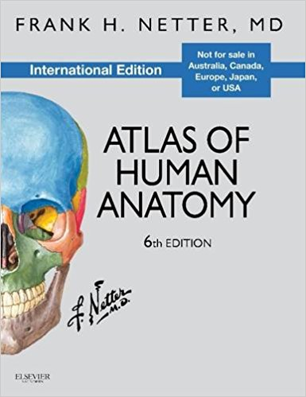

Slide 9
328833 611(084.4) N47 Netter, Frank Henri (1906-1991). Atlas of human anatomy / Frank H. Netter. - 6th ed. - Philadelphia (Pa) : Saunders : Elsevier, 2014. - [12], 531, [6], I-43 p. : il.
The gold standard of excellence for 25 years, Frank H. Netter, MD’s Atlas of Human Anatomy offers unsurpassed depictions of the human body in clear, brilliant detail – all from a clinician’s perspective. With its emphasis on anatomic relationships and clinically relevant views, Dr. Netter’s work provides a coherent, lasting visual vocabulary for understanding anatomy and how it applies to medicine today.

Slide 10
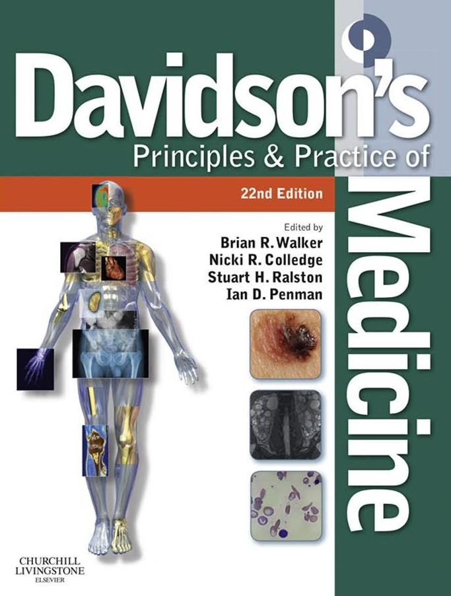

Slide 11
323976 616.1/.9(075.8) D26 Davidson's principles and practice of medicine / edited by: Brian R. Walker [et. al.] ; illustrations by Robert Britton. - 22nd ed. - Edinburgh [etc.] : Churchill Livingstone : Elsevier, 2014. - XIX, 1372 p. : il.
More than two million medical students, doctors and other health professionals from around the globe have owned a copy of Davidson’s Principles and Practice of Medicine since it was first published. Today’s readers rely on this beautifully illustrated text to provide up-to-date detail of contemporary medical practice, presented in a style that is concise and yet easy to read. Davidson’s provides the factual knowledge required to practise medicine, explaining it in the context of underlying principles, basic science and research evidence, and shows how to apply this knowledge to the management of patients who present with problems rather than specific diseases.

Slide 12
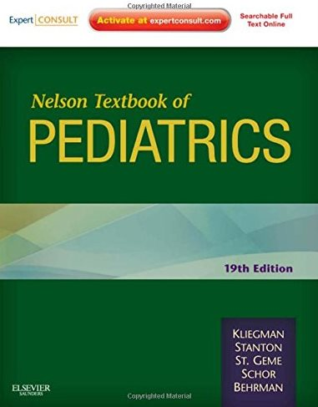

Slide 13
322145 616-053.2(075.8) N38 Nelson Textbook of Pediatrics / Robert M. Kliegman [et al.]. - 19th ed. - Philadelphia : Elsevier Saunders, 2011. - LXVII, 2610 p. : il.
Nelson Textbook of Pediatrics has been the world’s most trusted pediatrics resource for nearly 75 years. Drs. Robert Kliegman, Bonita Stanton, Richard Behrman, and two new editors - Drs. Joseph St. Geme and Nina Schor - continue to provide the most authoritative coverage of the best approaches to care. This streamlined new edition covers the latest on genetics, neurology, infectious disease, melamine poisoning, sexual identity and adolescent homosexuality, psychosis associated with epilepsy, and more. Best of all, the expanded online access at Expert Consult features the full text, case studies, new references and journal articles, Clinics articles, and exclusive web-only content so that you get even more out of this invaluable reference.

Slide 14
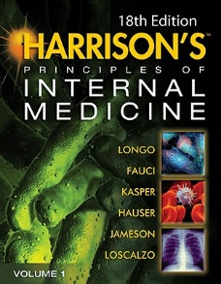
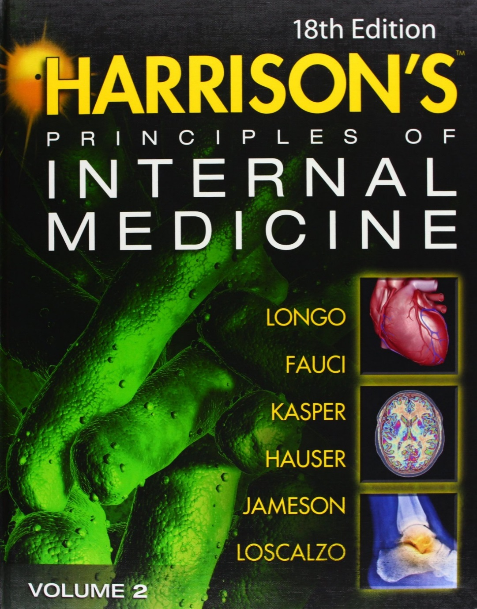

Slide 15
325164 616.1/.9(075.8) H30 Harrison`s principles of internal medicine / editors: Dan L. Longo [et al.]. - 18th ed. - New York [etc.] : McGraw-Hill, Medical, cop. 2012.
The most widely read textbook in the history of medicine.
Through six decades, no resource has matched the encyclopedic scope, esteemed scholarship, and scientific rigor of Harrison’s Principles of Internal Medicine, both as a textbook and as a clinical reference. It remains the most universally respected textbook in all of medical publishing and the pinnacle of current medical knowledge.
Presented in two volumes.

Slide 16
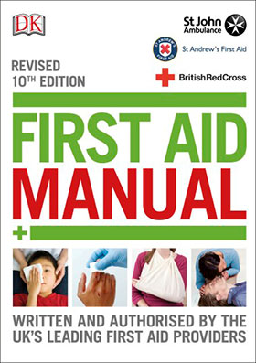

Slide 17
329527 614.88(075.8) F56 First aid manual : the authorised manual of St John Ambulance, St Andrew's First Aid and the British Red Cross / Margaret Austin, Rudy Crawford, Barry Klaassen. - 10th ed., revised. - London : Dorling Kindersley, 2016. - 288 p. : il.
The First Aid Manual, revised 10th edition for 2016 is the most up to date, fully packed and comprehensive guide to first aid. Used as the official training manual for the UK’s leading first aid organisations this book is also suitable for everyone and could be a life saver.

Slide 18
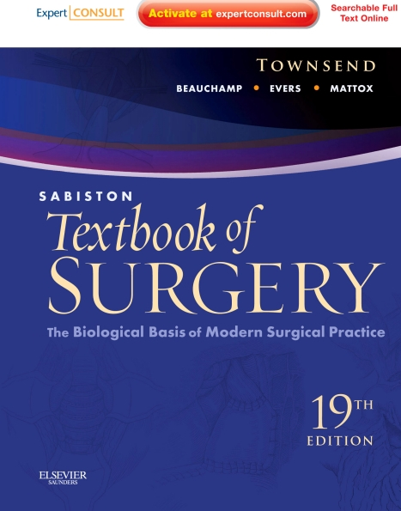

Slide 19
319091 617(075.8) S11 Sabiston textbook of surgery : the biological basis of modern surgical practice / [ed. by] Courtney M. Townsend et al. - 19th ed . - Philadelphia : Elsevier ; [S. l.] : Saunders, 2012. - XXV, 2124 p. : il.
Since its first publication in 1936, Sabiston Textbook of Surgery has been regarded as the preeminent source for definitive guidance in all areas of general surgery.
Sabiston Textbook of Surgery is your ultimate foundation for confident surgical decision making. Covering the very latest science and data affecting your treatment planning, this esteemed medical reference helps you make the most informed choices so you can ensure the best outcome for every patient.

Slide 20
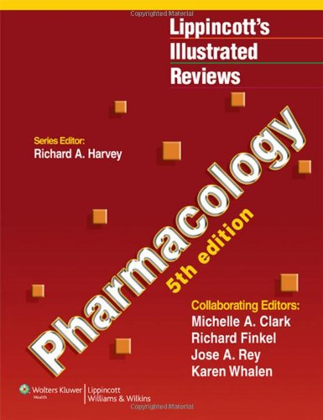

Slide 21
323982 615.015(075.8) P56 Pharmacology / Michelle A. Clark [et al.]. - 5th ed. - Philadelphia [etc.] : Wolters Kluwer : Lippincott Williams & Wilkins, copyright 2012. - XII, 612 p. : il.
Lippincott's Illustrated Reviews: Pharmacology, Fifth Edition enables rapid review and assimilation of complex information and focuses on the essentials of medical pharmacology. Clear, sequential pictures present mechanisms of action and actually show, rather than tell, students how drugs work. This book features a signature outline format with more than 500 full-color illustrations and cross-references to other volumes in this bestselling, student-oriented series.

Slide 22
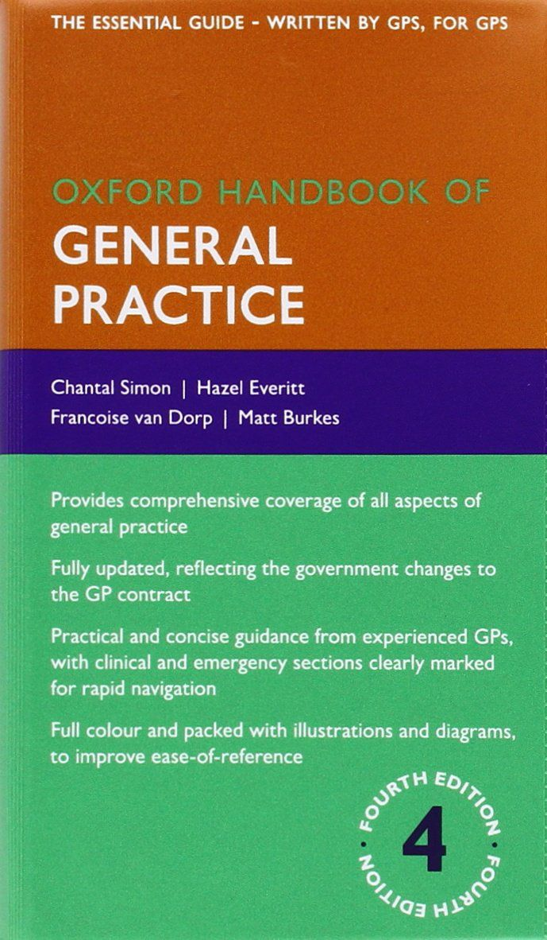

Slide 23
326585 616.1/.9(075.8) O-97 Oxford handbook of general practice / Simon Chantal [et al.]. - 4th ed. - Oxford : Oxford university press, reprinted 2015. - XXVIII, 1157 p. : il.
Fully revised to reflect the new changes to the GP contract and the GP curriculum, this fourth edition of the best-selling Oxford Handbook of General Practice is a practical guide to all aspects of general practice; from vital clinical information, to valuable practical guidance from experienced GPs. This is the essential guide for all those working in general practice.
Comprehensively covering everything a doctor needs to work in, or manage a GP practice, this handbook ensures readers are always up-to-date with the latest guidelines, the most recent protocols, and cutting-edge clinical information.

