Slide 1
From Dior to Valentino. The most expensive outfits

Slide 2
Every woman strives to look elegant and stunning. Very often, in order to express their elegance, originality and delicate taste, women “arm themselves” with exclusive dresses from the most expensive designers, sparing no sums for this, sometimes even sky-high.

Slide 3
The creators of the outfits, in turn, do not waste time in vain, trying their best to create something unique, so that the ladies dressed in their creations shone brighter than anyone else. We present to your attention a rating of just such dresses - striking not only with their luxurious appearance, but also with their fabulous price.

Slide 4
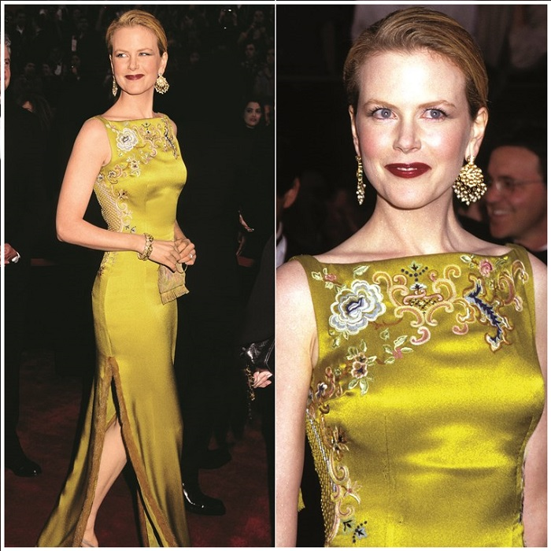
9th place:
Nicole Kidman graces this list as one of the only two entries who wore dresses that breached the million-dollar mark. Valued at $2 million, Kidman’s outfit was made by Christian Dior Haute Couture, which was crafted using a striking gold-green double tone.

Slide 5
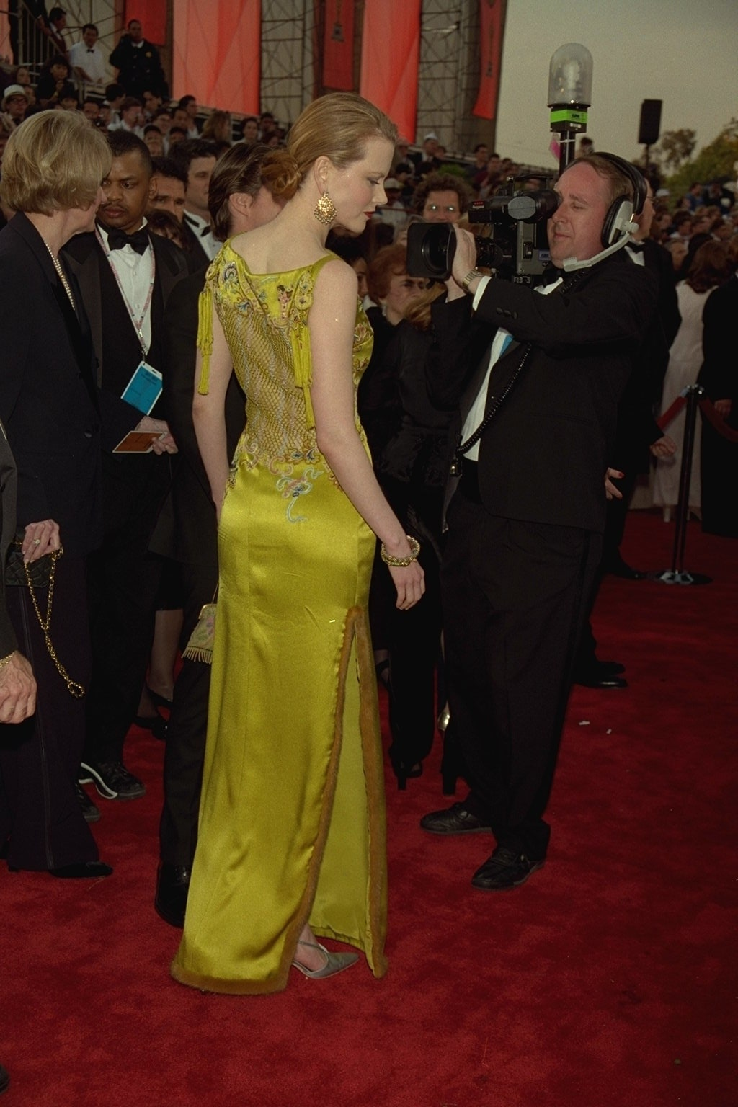
The dress was highlighted with intricate embroidery, a high neck and a slit at the right side. The expensive dress is now branded as one of the most iconic dresses ever worn at the Oscars.

Slide 6
8th place:
Jennifer Lawrence, lovingly called J-Law by adoring fans, went to the 2013 Oscars in a Dior Couture creation, a blush-pink ballgown whose design made it difficult for Lawrence to climb the stairs to collect her Oscar award for Best Actress (she actually tripped). Valued at $4 million, the dress was lent to Lawrence as she was the face of the brand.

Slide 7
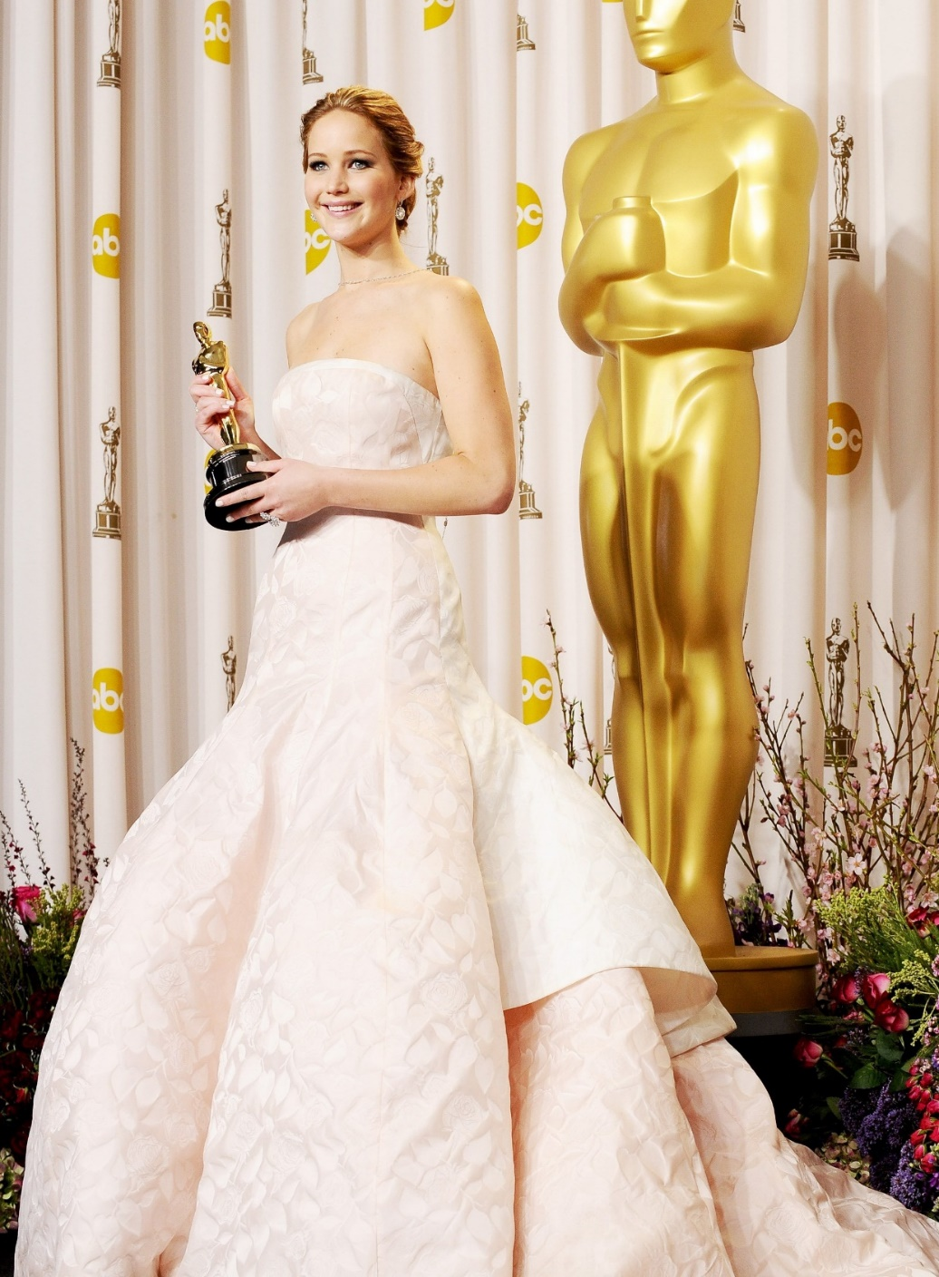
The tripping incident also proved to be a blessing for Dior Couture, as it gave the dress extended air time and publicity, which would have cost the company millions otherwise.

Slide 8
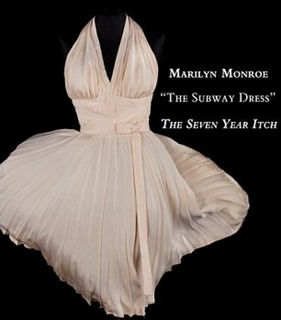
7th place:
Marilyn Monroe's "fly away" dress is the famous wardrobe item of the Hollywood actress, who became famous thanks to the film "The Seven Year Itch" by Billy Weider. The episode from this film, where the flow of air from the ventilation system raises the pleated skirt of a white dress, exposing the legs of the heroine, made Marilyn Monroe a sex symbol of her time. In 2011, in Los Angeles, at the auction house Profile in History, it was sold for $4.6 million.

Slide 9
Boop-boop-be-doop!

Slide 10
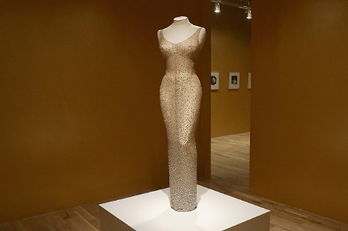
6th place:
In November 2016, this dress was sold at Julien's Auctions in Los Angeles for $4.8 million, while the organizers expected to get a much smaller amount for it: from two to three million. - no" collector Robert Ripley.
"Happy Birthday" - Marilyn Monroe's famous translucent dress, which she wore to John F. Kennedy's birthday on March 19, 1962. The initial cost of the outfit, created by order of the actress by designer Jean Louis, was 12 thousand dollars. It is sewn from a web-like fabric embroidered with 6,000 diamond sequins.

Slide 11
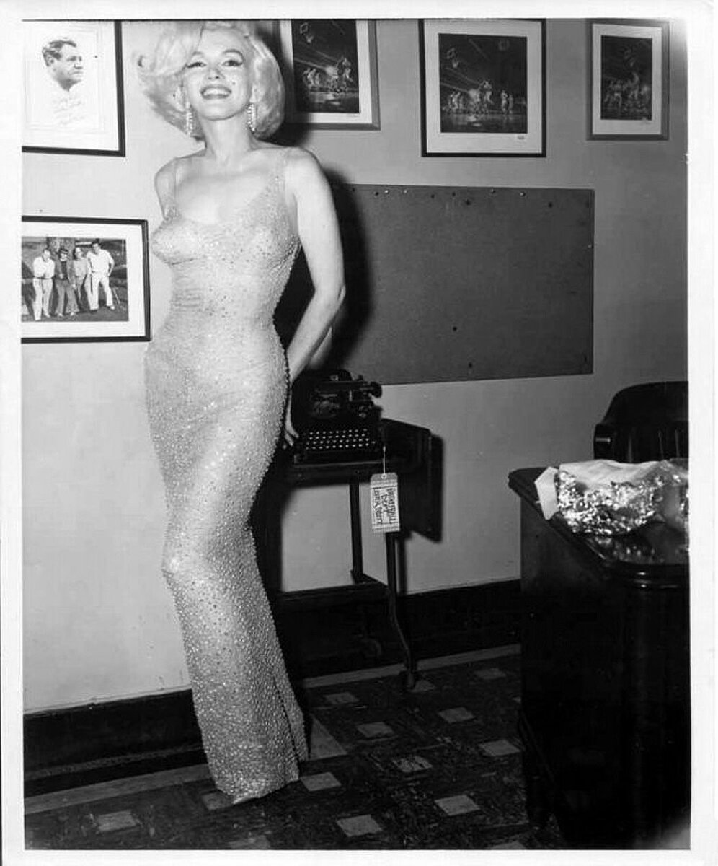

Slide 12
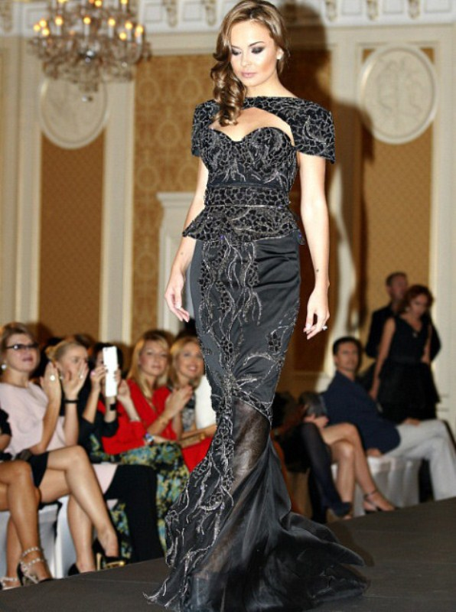
5th place:
British designer Debbie Wingham's luxurious toilet is a black dress, hand-sewn from crepe de chine, satin and chiffon, completely encrusted with white and black diamonds (from 2 to 5 carats), some of which are even bordered with gold. The creator of the dress, first shown to the public in Monte Carlo, worked on her masterpiece for six months, making 50,000 stitches with her own hands. The cost of this work of art, weighing 13 kg, is 5.6 million dollars.

Slide 13
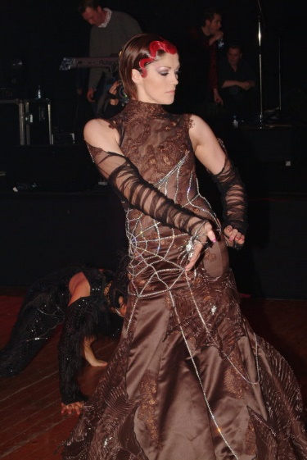
4th Place:
A black cobweb dress embellished with 2,500 diamonds, presented by Belgian designer Nicky Vankets in 2005, worth $6.5 million.

Slide 14
3rd Place:
Scott Henshall's $9 million diamond dress is a finely woven cobweb embellished with 3,000 diamonds. Its owner, singer Samantha Mamba, purchased an exclusive outfit for the premiere of Spider-Man 3, which took place on July 28, 2004.

Slide 15
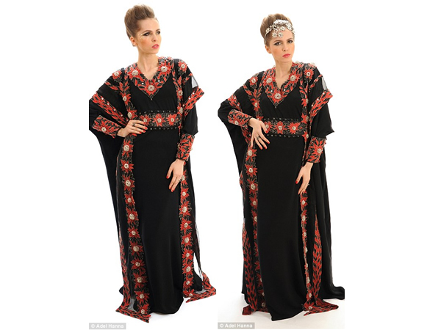
2nd place:
Abaya (traditional Muslim dress), created by British fashion designer Debbie Wingham in Dubai, is estimated by specialists at $17.7 million. The black dress is embroidered with gold threads and adorned with 2,000 diamonds, including white, black, and rare red diamonds. The presentation of the dress to the world took place on March 20 this year in one of the most elite hotels in Dubai.

Slide 16
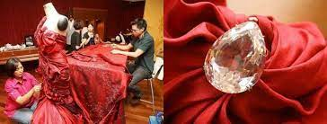
1st place «Nightingale of Kuala Lumpur»
Nightingale of Kuala Lumpur - the most expensive dress in the world, created by Malaysian designer Faiyzali Abdullah, the cost of which reaches a fantastic amount - 30 million dollars. A burgundy-colored evening gown made of taffeta and silk is studded with 751 diamonds, and crowns this magnificence of luxury and brilliance with a pear-shaped diamond weighing 70 carats. A long train, also embroidered with small diamonds, completes the look. "The Nightingale of Kuala Lumpur" was first presented to the public in 2009 at the STYLO Fashion GrandPrix KL festival.

Slide 17
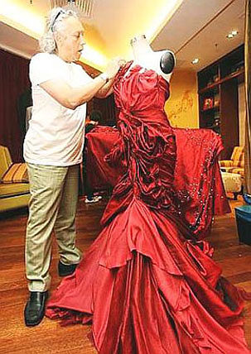

Slide 18
It is quite difficult to determine which of the dresses can be considered the most luxurious and expensive. There are always a lot of myths around such models, because often information about the cost of a dress is passed from mouth to mouth, or arises from the words of journalists greedy for sensation. One thing is invariable: the first appearance of such outfits in public causes delight, captures attention, and the images are remembered for a long time. Photos of the most expensive dresses are fascinating, because in everyday life we ​​do not have to contemplate outfits made of gold fibers, coins, threads interspersed with diamonds.

Slide 19
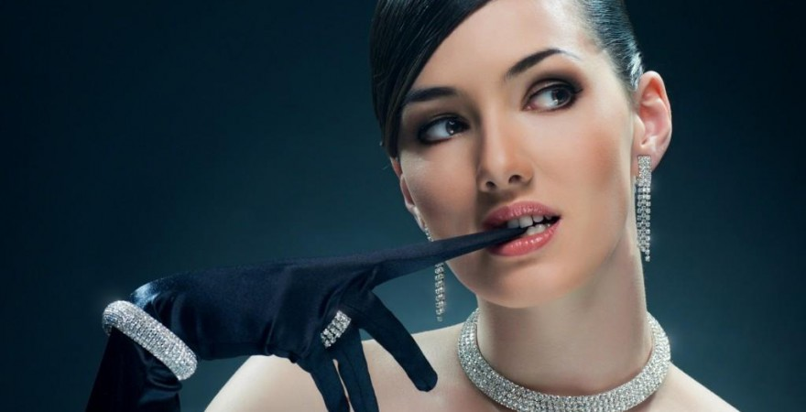
Thank you for your attention and dress up!
and shine bright like a diamond!

