Slide 1
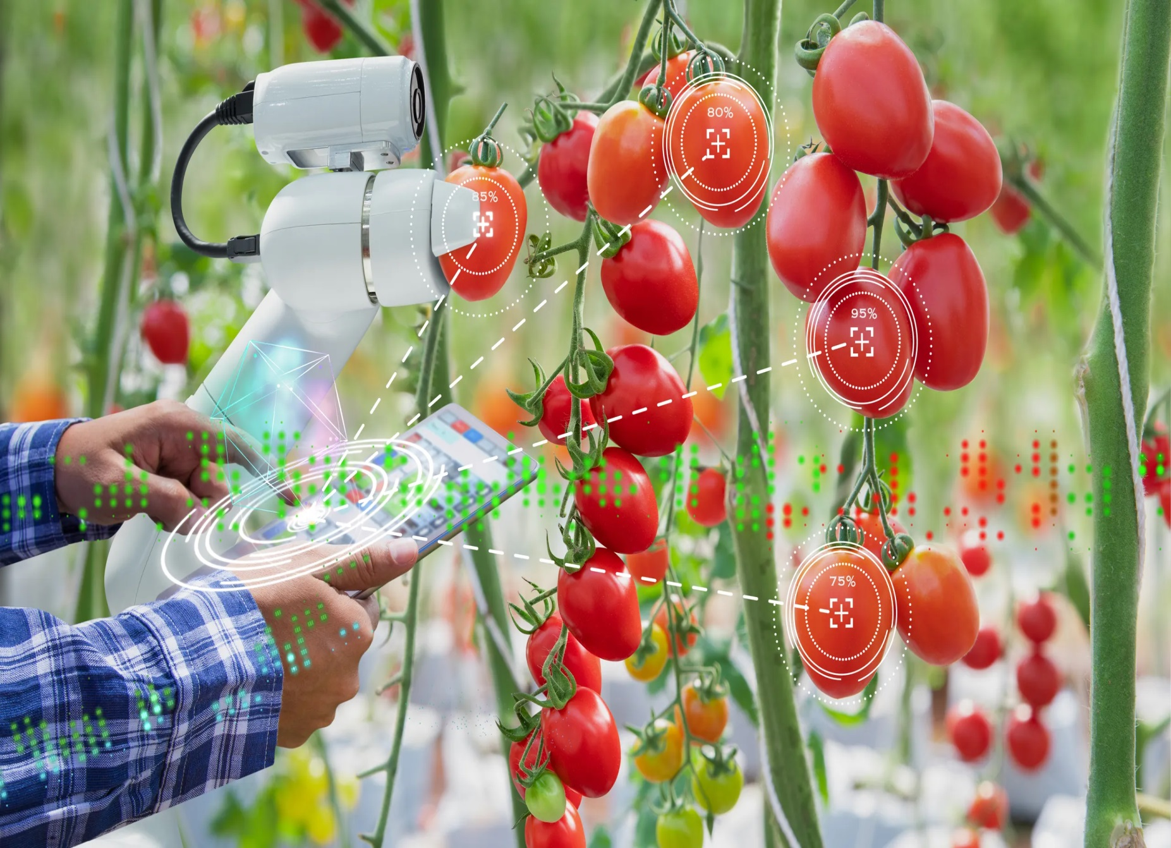
Food of the Future

Slide 2
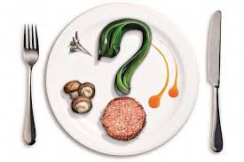
Science is moving forward, the world is changing, and the changes affect all spheres of our life, even the contents of one’s refrigerator. The past century has brought us microwaves, multicookers and a craze for Japanese cuisine. What else is progress to give people?

Slide 3
Why Do We Need Changes?
People seem to know so much about food. So, there is no need to teach them what to eat. People can buy food or cook their own food. They know how wheat grows, how bread is baked. They know that cows grazing in pastures give milk. They know that not all plants are edible. And then all of a sudden scientists want to break the usual order of things. They want to print bread instead of baking it. They even want to make everybody eat inedible flora and fauna.
This is not simply someone’s whim. Unfortunately, the population of our planet is rapidly increasing while the condition of the environment is deteriorating. The present day food industry can’t meet the needs of all mankind. Besides, more and more people are worried about their health and environment protection when choosing what to eat. It means we can’t avoid new food sources. Let’s find out what they are going to feed us on in a couple of decades.

Slide 4
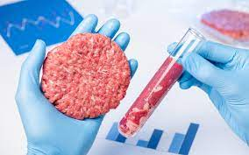
LAB-GROWN MEAT
Scientists want to solve the problem of cattle breeding with the help of stem cells, on the basis of which they hope to grow real synthetic meat. Growing meat in laboratories will require 7−45% less energy consumption, reduce the exploitation of land resources by 99% and greenhouse gas production by 78−96%.
It takes a long time for cows to grow up while meat in laboratories can be grown immediately.
Also if we want to stop wars, we shouldn’t kill not only humans but mammals and birds as well. Research studies show that they are not so far behind us in intelligence.

Slide 5
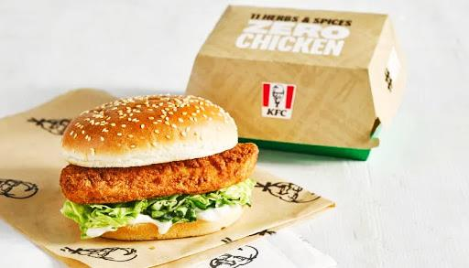
Already today anyone can try artificial meat. The KFC fast food restaurant chain, whose signature dish is fried chicken wings, has decided to introduce vegetable based meat to its clients. If the visitors’ reaction is positive, the vegetarian wings will go on sale widely.

Slide 6
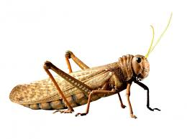
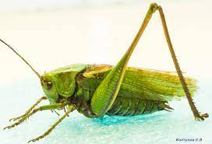
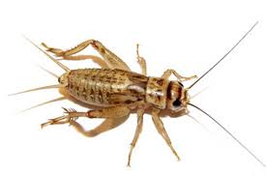
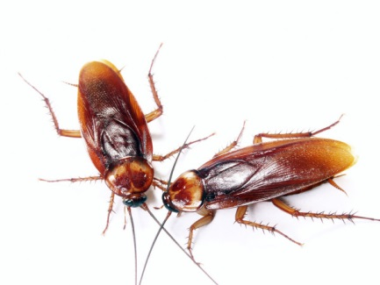
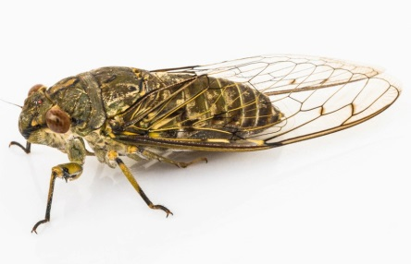
INSECTS
In Asia insects are considered to be a delicacy. In many post-apocalyptic movies and books cockroaches and worms become people’s main diet. And there is a grain of common sense in this as it is almost pure protein. And insects are also easy to grow. Pasta with an admixture of grinded insects is already being sold today.

Slide 7
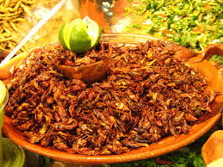
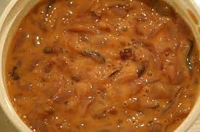
Some Recipes
Fried Grasshopper Salad
Heat the oil in the frying pan and fry some grasshoppers in it after removing their hind legs. Grate the raw beetroots and carrots. Add chopped grasshoppers and walnuts. Mix well and season the salad with orange zest oil.
Silkworm Paste
Fry some garlic, then add silkworms and salt. Add some pepper and herbs. Pour it over with white wine and simmer for 15 minutes. Chop the mixture in blender.

Slide 8
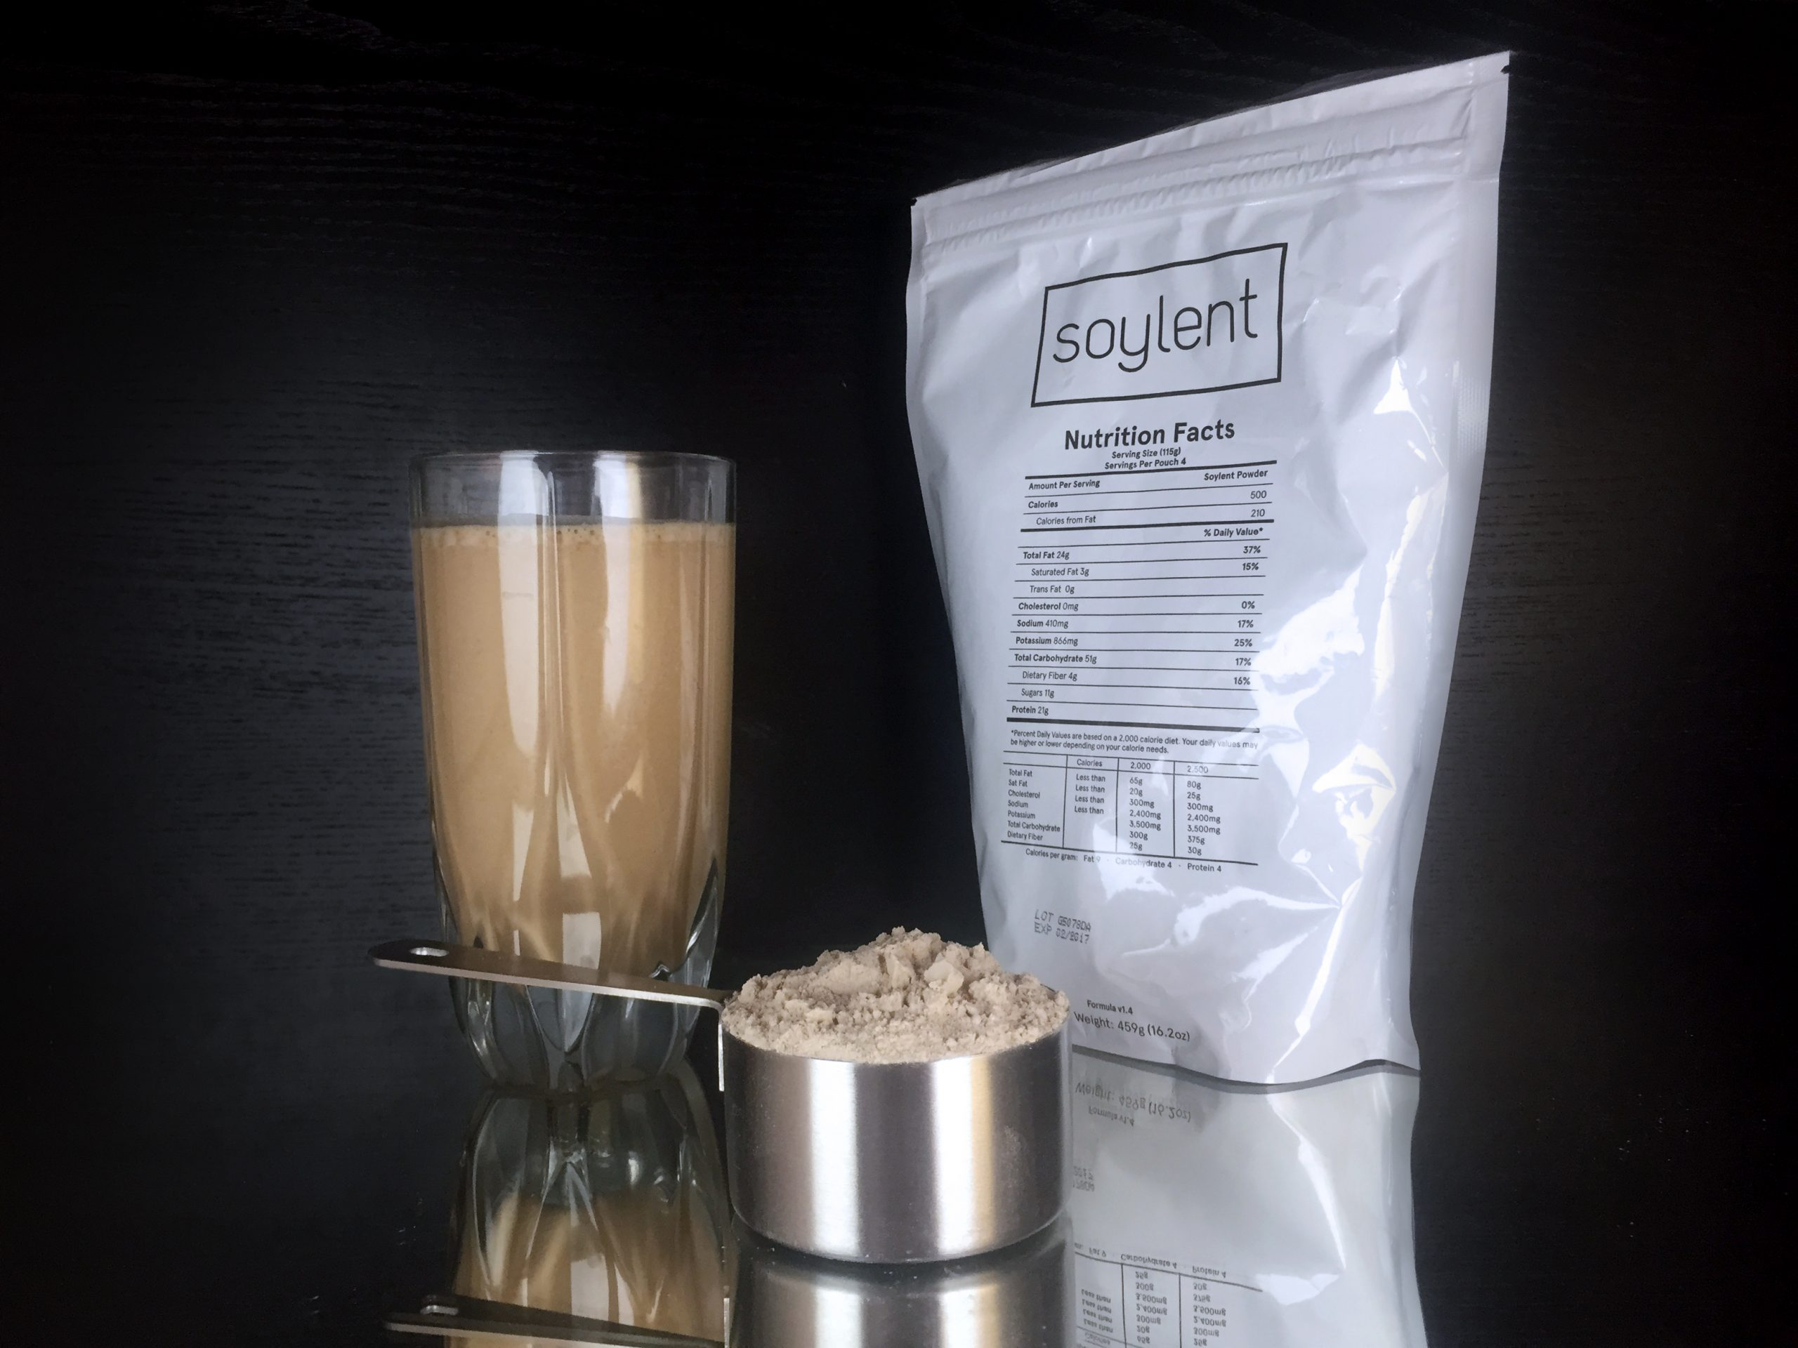

Slide 9
SOYLENT
Have you ever dreamt of a pill that can substitute food or some powder a couple of spoons of which would be enough to feel full? Soylent powder contains protein, fat, carbohydrates, vitamins, amino acids, fiber and microelements. It can be considered a sports cocktail except that it is meant for ordinary people.
Soylent can easily replace traditional meals when you can’t go out to eat. It will cost you a little cheaper than you usually pay for an ordinary lunch.
Soylent has its disadvantages as well. You may not feel full — a person needs to see food to feel full. It is also impossible to completely switch to Soylent — our body is not adapted to drinking cocktails only. But in case of proper preparation and consumption this powder can work wonders.

Slide 10
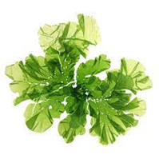
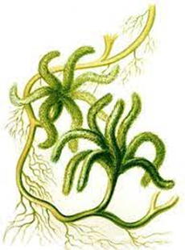
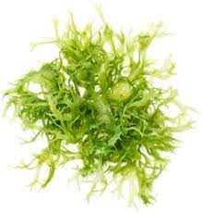
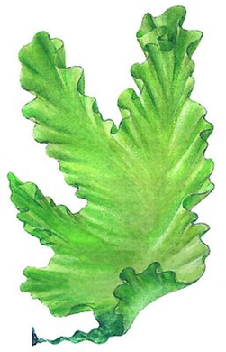
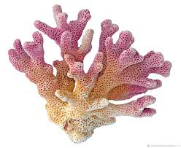
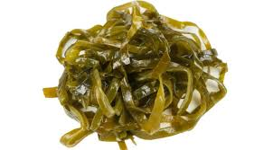
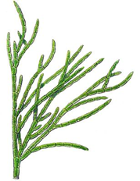
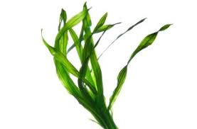

Slide 11
ALGAE
Microscopic algae, like other plants, absorb carbon dioxide from the atmosphere. A 2013 study showed that these tiny green organisms produce an impressive amount of protein, fat and carbohydrates, making them a goof source of nutrients. New studies also suggest that some types of algae contain a lot of omega-3 fatty acids, as well as other fatty acids that positively affect the functioning of the cardiovascular apparatus.
Unfortunately, the trial tests of microscopic algae as food products did not go very smoothly. Soylent has already marketed products containing ground algae. However, healthy food caused upset stomach in consumers, so sales had to be stopped. Nevertheless, the company’s executives hope to fix all the problems and make a new version of their seafood product.

Slide 12
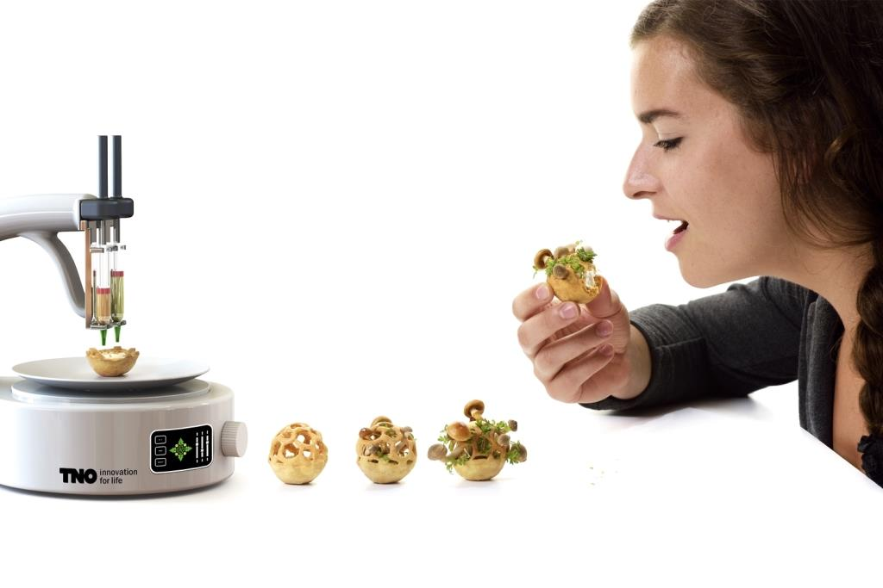
3D FOOD PRINTING
3D food printing can significantly save time on food preparation and make any food suitable for the elderly who tend to have some difficulties in chewing and swallowing.
Even NASA investors insist on astronauts eating not pasta but a balanced diet that will be possible to ‘cook’ with the help of 3D printing during long-distance flights. It is also important that printed food will always be hot and fresh.

Slide 13
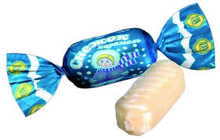
EATING CANDY AND ITS WRAPPER
Almost a third of waste is food packaging: all kinds of bags, boxes and wrappers. Yet, there is an option how to deal with all this garbage – making the packaging edible.
Harvard bioengineer David Edwards is working on this. Inspired by the cells of living organisms that easily retain water, Edwards came up with an idea of a similar package resembling the grape peel. It is waterproof, preserves products fresh and is suitable for storaging many products. The edible packaging consists of water, calcium, dietary fiber, and polysaccharide. Before use, the jelly-like packaging needs to be washed.
The British company Skipping Rocks Lab tried to create its own biodegradable container and developed a transparent jelly-like ball based on algae. To extract water from it, it is enough to tear the packaging. However, the British had difficulties with transportation: such balls turned out to be too fragile and burst on the way.
Well, let’s see what else scientists can invent.

Slide 14
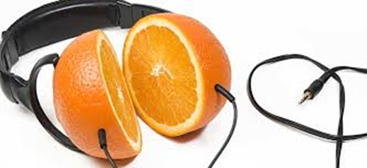

Slide 15
FOOD AND MUSIC
We pay a lot of attention not only to the taste of food but also to its appearance. We try to make dishes look beautiful. But is that all we need?
It turns out that listening to music when eating can not only affect the taste of the food but even make it better. This was discovered by scientists from Oxford University. They found out which frequencies make food seem more bitter and which ones more sweet. For example, high-pitched piano sounds make food sweet and the low sounds of brass instruments make it bitter.

Slide 16
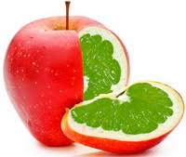
GMO FOODS
Realizing that traditional agriculture will not be able to feed the ever-growing population of our planet, scientists started creating GMO crops. It is necessary to create breeds that will contain more nutrients and provide a good harvest. At the same time they will be resistant to parasites and bad weather conditions.
However, people often do not trust GMOs and that is due to lack of knowledge. Some people even believe that GMOs can introduce their genes into human organisms.

Slide 17
We can only guess what food will be like in 50 – 70 years. Through ever emerging new technologies, cross disciplinary collaborations and a wider variety of foods coming to the market every year, we will definitely see a lot of foods and food trends that are hard to predict.
From advancements in genetic modifications to dining that stimulates all our senses. Already now, we’re pushing the boundaries further than ever before.
And the future will definitely bring us more creative food to the market.
So, who knows, maybe just a few years from now, you’ll be frying GM crickets with your smartphone.

Slide 18
