Slide 1
OBESITY:
The Plague of the 21st Century

Slide 2
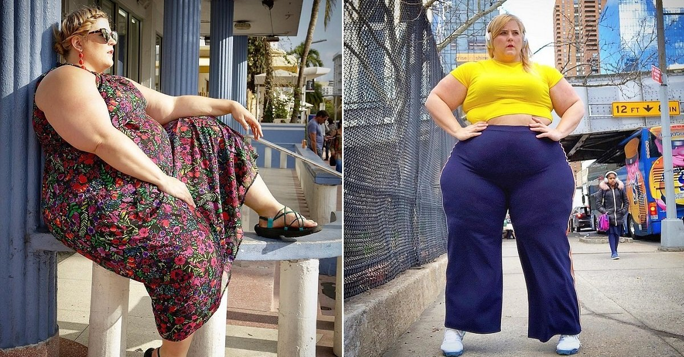
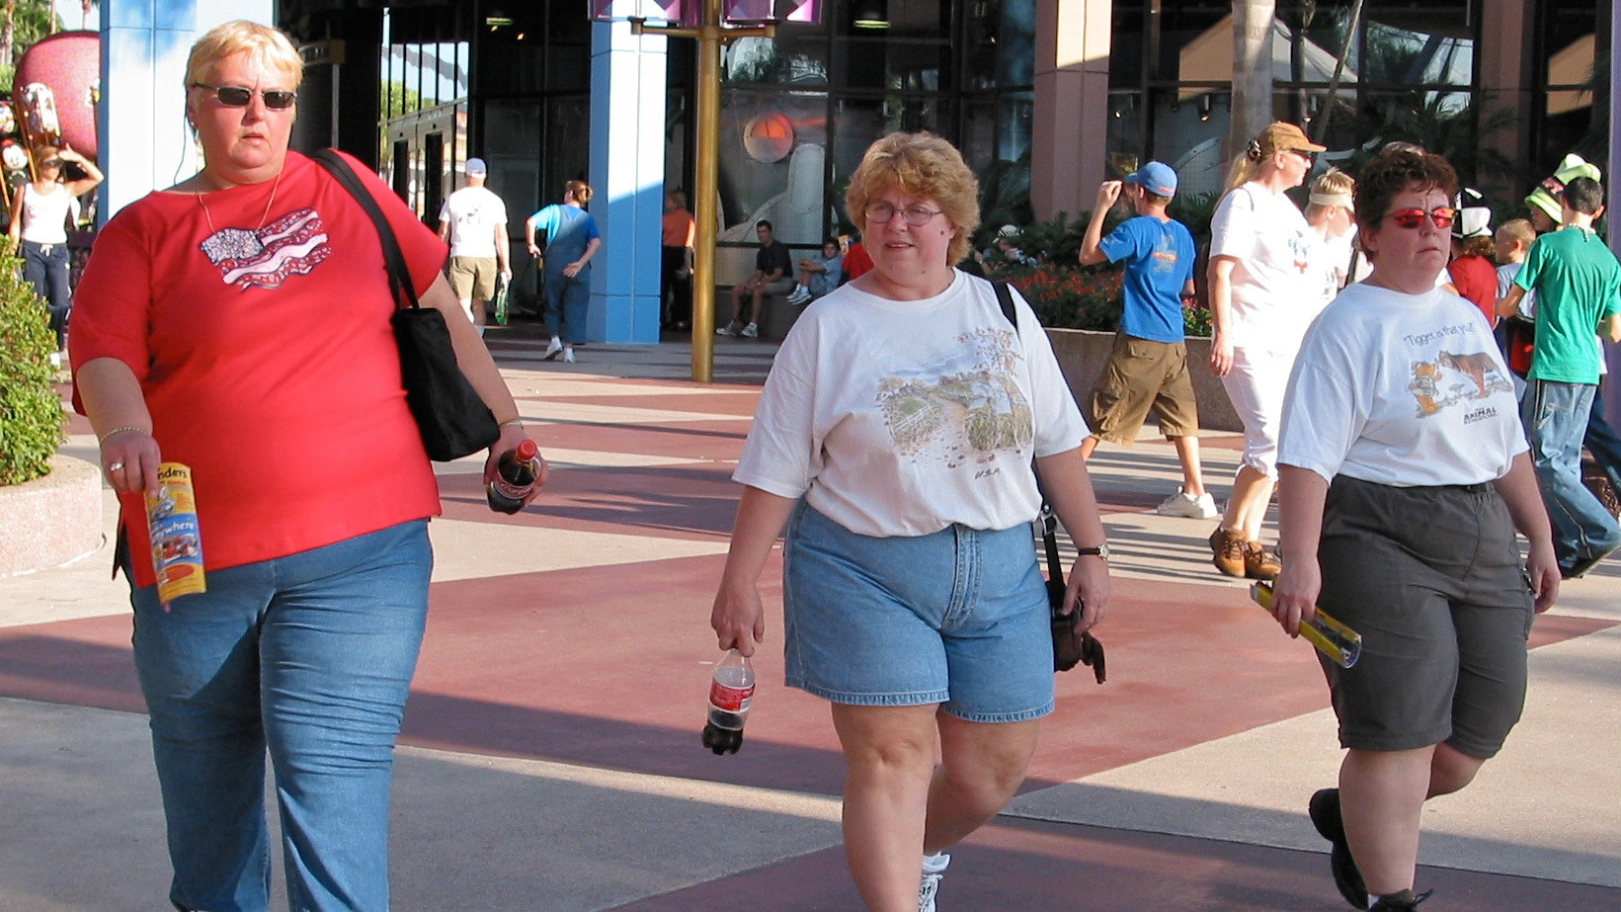
.
November 27
Anti Obesity Day

Slide 3
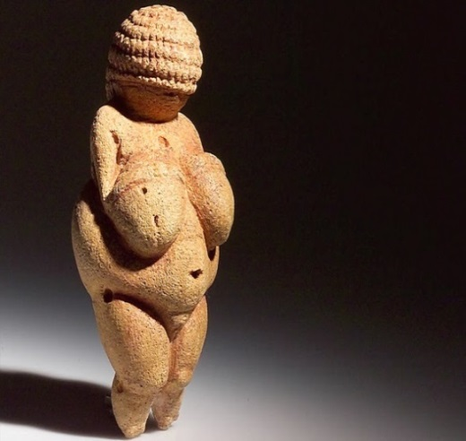
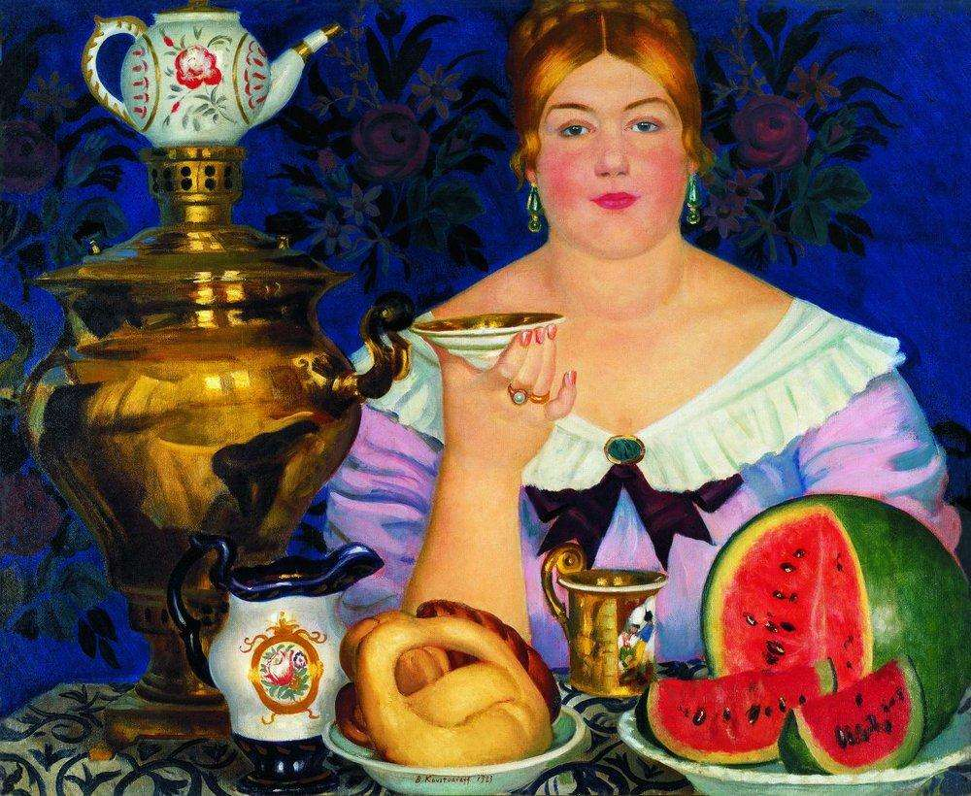
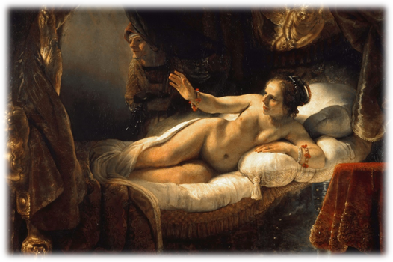
In the distant past, the ability to accumulate fat was an evolutionary advantage that allowed people to survive during periods of forced starvation. Overweight women were looked upon as a symbol of fertility and health.
In the 14th-16th centuries a pretty fat woman was considered to be ideal. Such plump ladies were painted by Kustodiev, Rubens, Rembrandt.

Slide 4
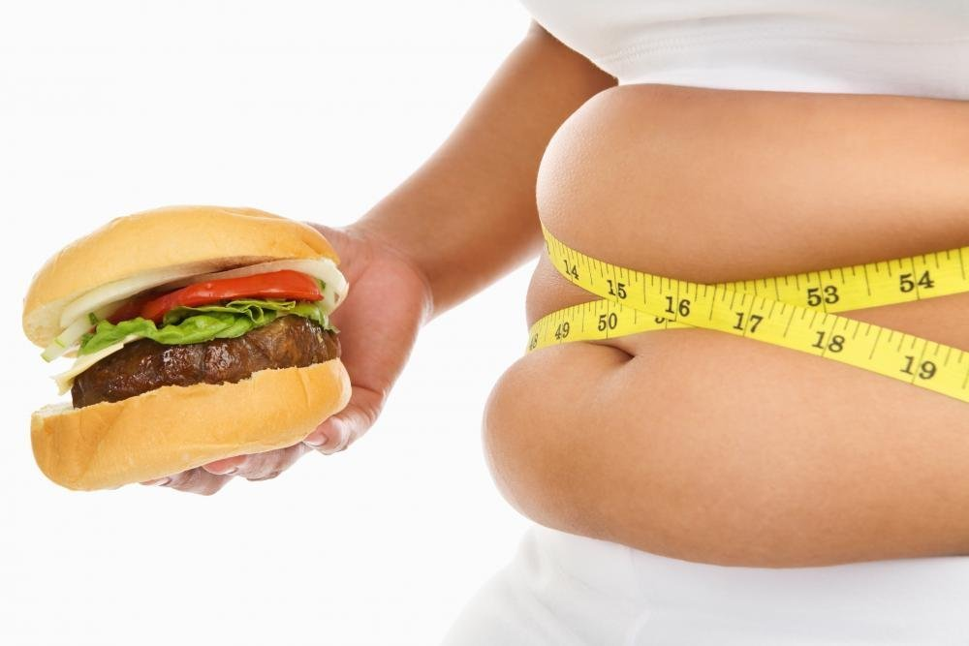
Nowadays lots of people suffer from overweight.
Imperial College London, together with WHO, has published a study on overweight. According to the scientists, every tenth man and every seventh woman in the world suffer from obesity. If things remain as they are now, by 2025 every fifth inhabitant of the planet will be overweight.

Slide 5
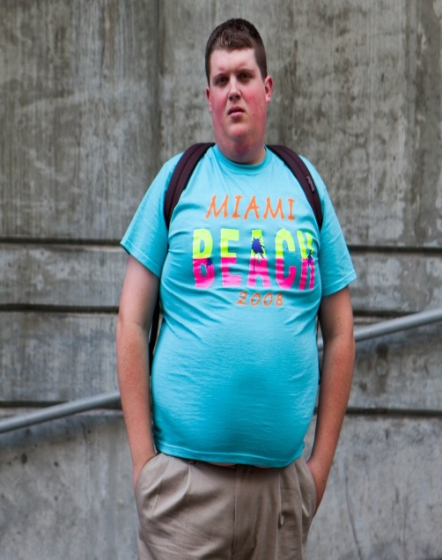
At the moment, Malta is one of the "fattest" countries in Western Europe - 28.9% of the population are obese. Next are: Great Britain - (27.8%), Hungary – (26.4%), Russia - (23.1%). In the USA, 32.8% of the population are diagnosed with obesity. This problem is also relevant for the CIS countries, where 48% of the population are overweight.

Slide 6
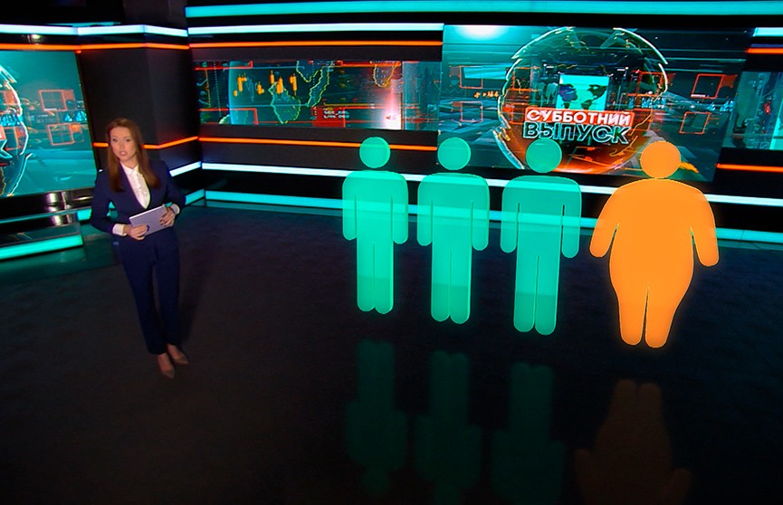
This problem is also relevant for Belarus. According to Belstat and the results of a study conducted by the Ministry of Health and WHO, 60.6% of the population are overweight. Every fourth resident of Belarus has obesity — 25.4%.

Slide 7
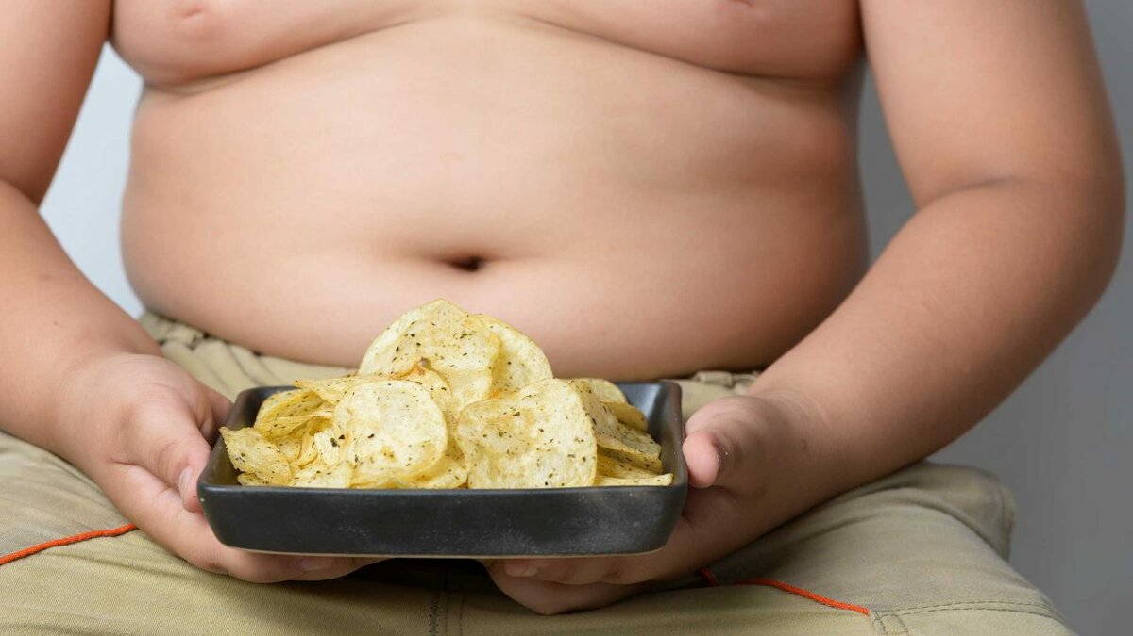
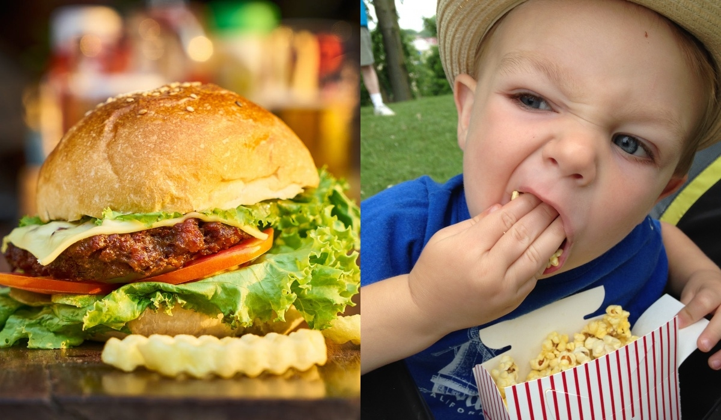
Doctors around the world are concerned about the spread of obesity among children. At first, this problem affected developed countries, but in the last ten years, similar processes have begun in China, Eastern Europe and the Middle East. About 15% of children in these countries suffer from obesity and overweight, and their number is constantly growing.
According to experts of the World Anti Obesity Organization, the epidemic will affect children 5-19 years old. This number will steadily continue to increase, reaching 250 million by 2030, and experts call children's eating habits the main factor influencing this trend. In addition, obesity provokes a sedentary lifestyle, lack of exercise, a large amount of time spent with gadgets.

Slide 9
Causes of Overweight
hereditary factors
overeating
unbalanced nutrition
sedentary lifestyle
some physiological conditions
long-term use of certain medications
chronic stress, insomnia

Slide 10
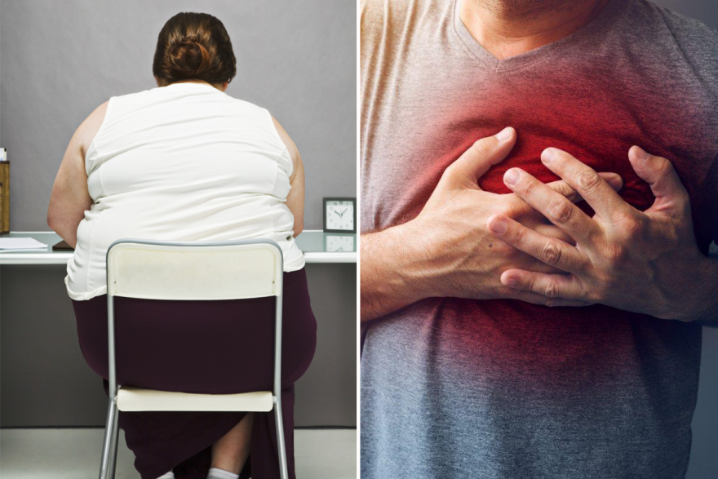
C
O
N
S
E
Q
U
E
N
C
E
S
OF OBESITY
Heart diseases
Type 2 diabetes mellitus
Oncology
Digestive problems
Fatty hepatosis
Cholelithiasis
Sexual problems
Sleep apnea
Osteoarthritis
Severe COVID-19

Slide 11
9 TRAGIC FACTS ABOUT OBESITY:
In the modern world more people suffer from obesity than from hunger.
People who have breakfast or lunch in a café are more likely to become obese.
Even if you stick to healthy eating habits but don’t sleep enough, you can gain up to 1 kg a week.
Americans are not the fattest people as it is believed. They take the 11th position and have only 32% of fat people.
The status of the ‘fattest’ country in the world belongs to Kuwait. 42% of its residents suffer from obesity.
More than 20% of the US health budget is spent on the treating obesity-related diseases. It makes it more than $ 200 billion.
Although obesity is associated with a luxurious lifestyle, research results say that obesity is more common with poor people.
One of the most dangerous products is candy (lollipops). An average American has almost 25 pounds (11 кг) of lollipops a year which can’t but affect their weight. In New Zealand a person suffering from obesity may be refused a residence permit.

Slide 12
If you’ve decided to lose weight, working out won’t be enough. You can’t lose weight by simply exercising. You should change your eating habits as well.

Slide 13
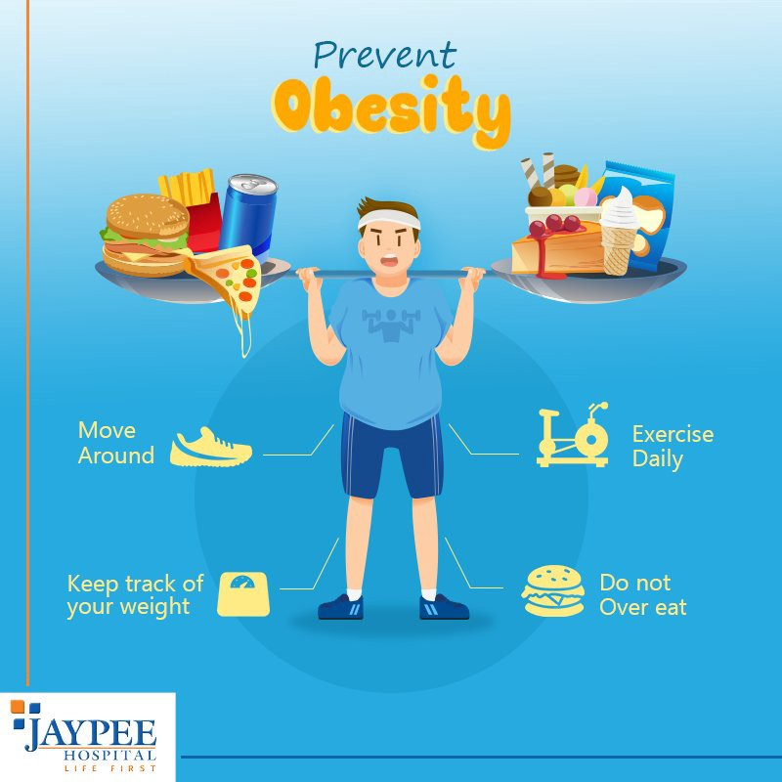

Slide 14
Consult a nutritionist or an endocrinologist. First of all, the doctor will prescribe an examination to determine the cause of weight gain. After the examination, the doctor will develop treatment tactics.

Slide 15
There are special medications aimed at reducing body weight. They
suppress the appetite;
reduce fat absorption;
regulate carbohydrate metabolism;
control the saturation center in the brain.
Such drugs have a wide range of side effects. Consult a doctor before using them.

Slide 17
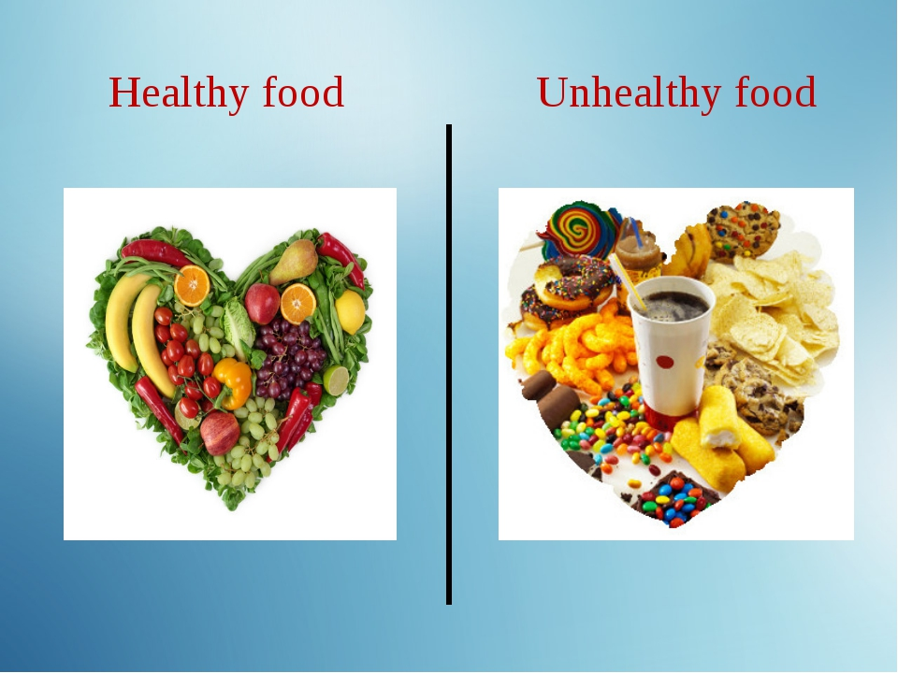
Nutrition and Obesity

Slide 18
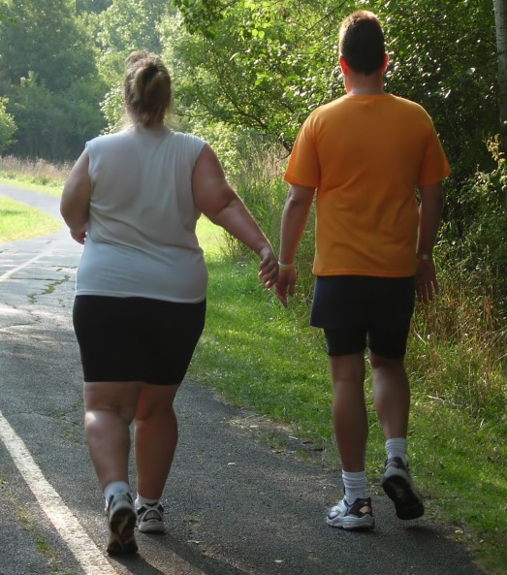
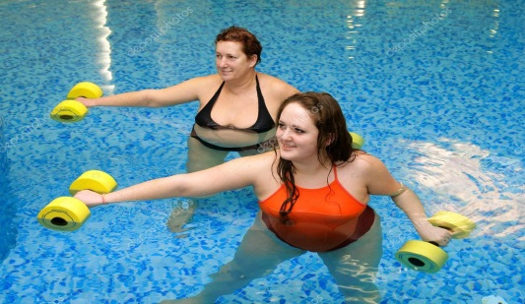
Obesity and Physical Activities
SWIMMING
WALKING
CYCLING
ORIENTAL DANCE
AQUAAEROBICS

Slide 19
You should remember that obesity is a chronic disease which can’t be treated by a temporary diet.
In most cases people start gaining weight again after dropping the diet.
The only way to get rid of obesity is to develop a balanced diet and stick to it all the time.

Slide 20
Never miss an opportunity to improve your looks
!

Slide 21
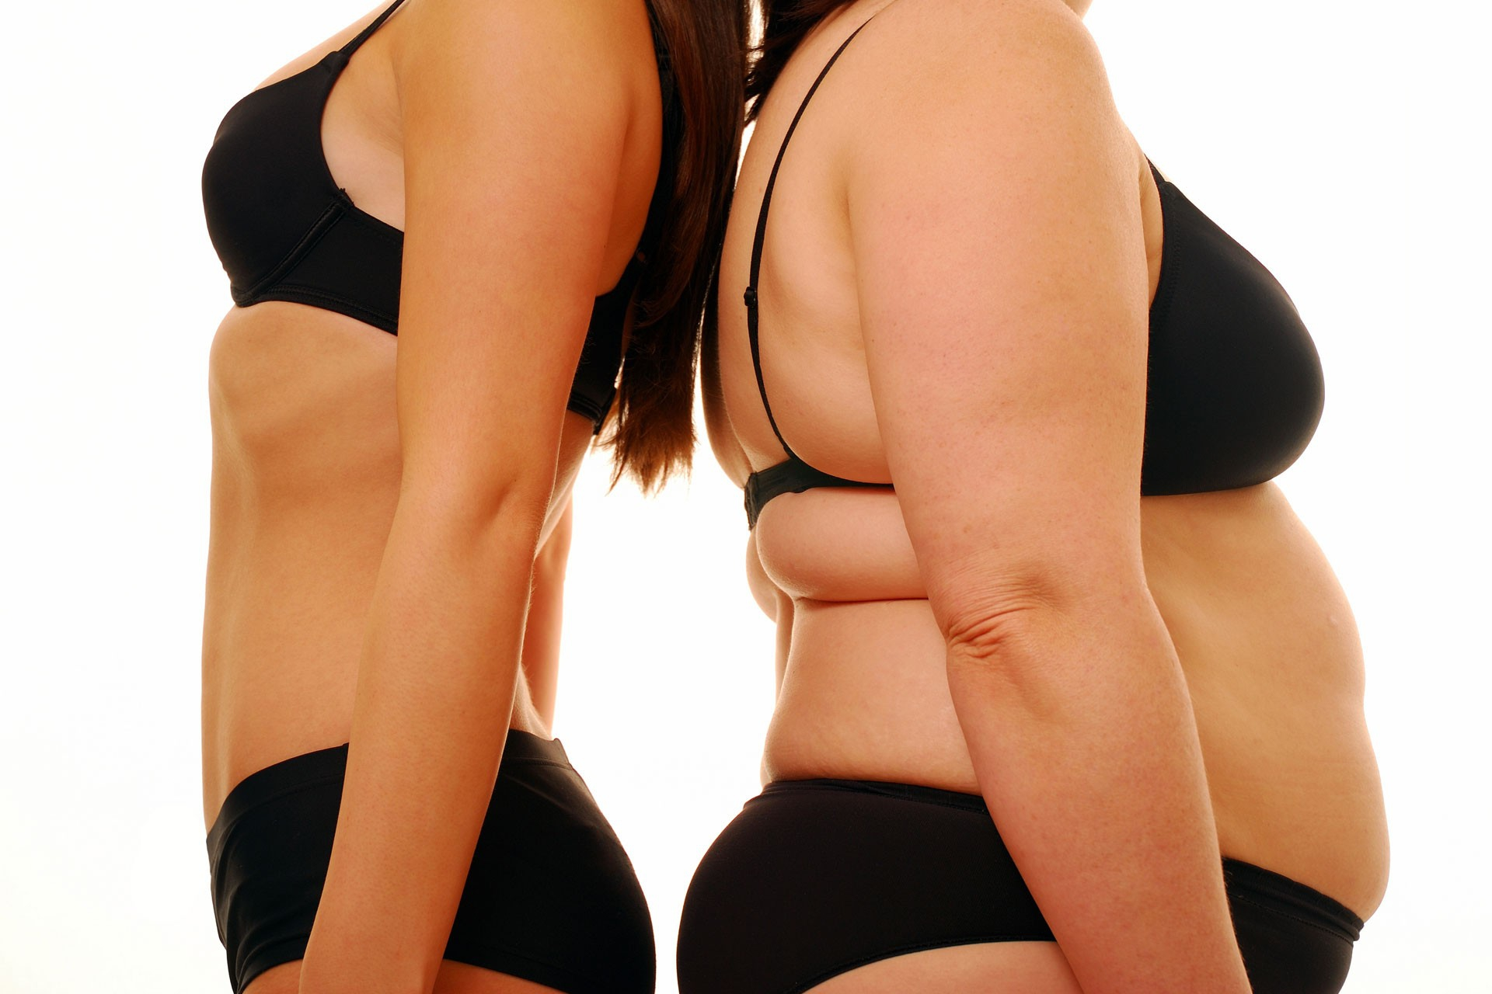
You still don’t think that obesity is a deadly danger?
Obesity takes 5th place in the world in the ranking of death causes.
Every year at least 2.8 million people die due to obesity or overweight.

