Slide 1
Education is the key to the success
(free online resources for self-education)

Slide 2
Civil rights activist Martin Luther King, Jr. once said, “The function of education is to teach one to think intensively and to think critically. Intelligence plus character — that is the goal of true education.”

Slide 3
Education is a process of imparting skills, knowledge, values in a formal setting and then evaluating students’ knowledge to check their progress. This is done in order to find a suitable job and make a successful career.
There are many fantastic reasons that education is good for us — and many ways in which it can be the key to professional success.

Slide 4
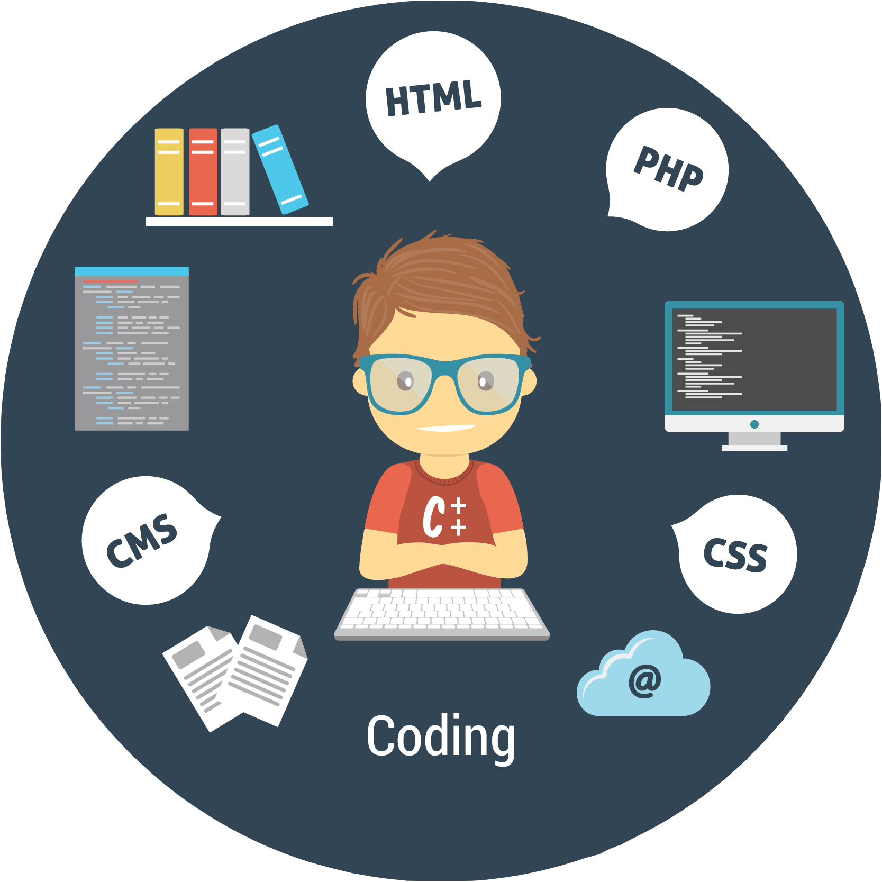
Education helps you channel your energy
Education is important because it helps us develop a unique perspective of looking at life. Education is not limited up to your academia but also cover every other aspect of your lives. Being good in academics doesn’t make your literate but being a good person is what makes you literate.

Slide 5
The more knowledge you gain the more opportunities will open up to allow individuals to achieve better possibilities in career and personal growth.
To survive in this growing and this competitive world, education is something that needs to be addressed and that needs to be handled carefully. It develops the personality of the people, provides physical and mental standard and transforms people’s living status.

Slide 6
We live in the internet age
Nowadays people have a lot of opportunities to learn something new every day.an incredible amount of information is available to you thanks to the internet. We have prepared a list of useful platforms for you to learn something online for free (еng&rus).

Slide 7
Coursera
Coursera is just about the best online learning platform out there, as well as one of the most popular. They collaborate with over 190 top companies and universities, such as Google, IBM, Stanford, and the University of Pennsylvania, and they have thousands of courses and specializations to study completely online.
On top of the regular free online learning courses, you can also earn professional certificates and full university degrees for a nominal fee. Or, you can join Coursera Plus, which is around $59/month, where Coursera offers unlimited access to take as many courses and classes as you want with full certificate benefits! You can get a 7 day free trial here.

Slide 8
Some options on their online learning platform include:
Google IT Support Professional Certificate
Negotiation, Mediation and Conflict Resolution Specialization
Master of Computer and Information Technology
Introduction to Physical Chemistry

Slide 9
Canvas
Unlike edX or Coursera, which each have big names on board as far as universities, Canvas is a MOOC platform with smaller local universities and community colleges teaching its online courses. Some of these include the University of Colorado Boulder, Vrije Universiteit Brussel, and the Swinburne University of Technology. Also, rather than simply offering courses for anyone, Canvas caters more towards teaching current instructors as well as the next generation of educators.

Slide 10
Some individual courses on their e-learning platform include:
University Governance and Academic Leadership
Safe and Resilient Schools: Threat Assessment and School Safety
Writing In The Disciplines Professional Development Course

Slide 11
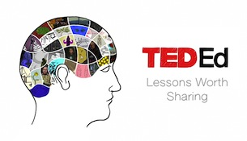
From TED, the founders of the world-famous TED conferences and TED talks, comes TEDEd, an initiative that aims to encourage and enable young people to learn interesting topics online for free. Unlike most other MOOCs on this list, the topics here are more everyday and conversational.

Slide 12
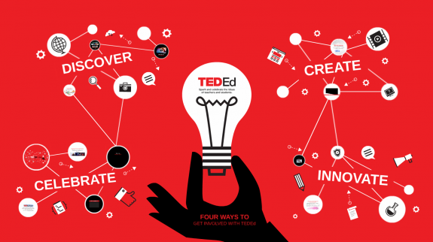
Some options on their online learning platform include:
How One Scientist Took On the Chemical Industry
How Can We Solve the Antibiotic Resistance Crisis?
Why Isn’t the Netherlands Underwater?
What It’s Like to Be a Muslim in America – Dalia Mogahed

Slide 13
Kadenze
Kadenze bills itself as “the future of STEAM education,” and they collaborate with leading institutions around the world to offer courses in science, technology, engineering, art, design, music, and math. Their partners include Princeton University, Berklee, Paris College of Art, Calarts, and RISD.
Some options on their online learning platform include:
Introducing Entrepreneurship for Musicians
Harnessing the Power of the Team: Teacher, Child, and Parent in Beginning Piano Study
Introduction to 3D Modeling and Animation with Maya: Tradition Meets Technology
Charting the Avant Garde: From Romanticism to Utopic Abstraction

Slide 15
EDX is an American massive open online course (MOOC) provider created by Harvard and Massachusetts Institute of Technology (MIT).
It hosts online university-level courses in a wide range of disciplines to a worldwide student body, including some courses at no charge. It also conducts research into learning based on how people use its platform. edX is a nonprofit organization and runs on the free Open edX open-source software platform. More than 150 schools, nonprofit organizations, and corporations offer or plan to offer courses on the edX website. As of 20 July 2020, there are 3,000 courses available for its 33 million registered students.

Slide 16
ART
Drawspace is one of the largest and most popular drawing training sites. You just choose a picture and you are shown step by step how to draw it.
Cambridge in Color is a website that helps photographers improve their skills. Here you can learn how to shoot and process digital photos using visual examples, as well as read tips for shooting specific subjects.

Slide 17
For learning foreign languages
Duolingo
Language of instruction: Russian.
Popular language resource. The platform has a user-friendly interface; the complexity and frequency of tasks depends on your language level, and there are also reminders so that you don't miss a lesson - it's convenient!
Livemocha
English language.
A resource where you can teach someone your native language in exchange for being taught some foreign language too. Maybe you can make friends all over the world.

Slide 18
Live Lingua Project.
MIT OpenCourseWare.
Internet Polyglot.
The Open University LeaningSpace.
Language learning podcasts.
Madinah Arabic Language Course.
BBC Languages.

Slide 19
Thenewboston
English language.
YouTube channel with video tutorials on learning React, Django, Python, Java, PHP for beginners and advanced developers.

Slide 20
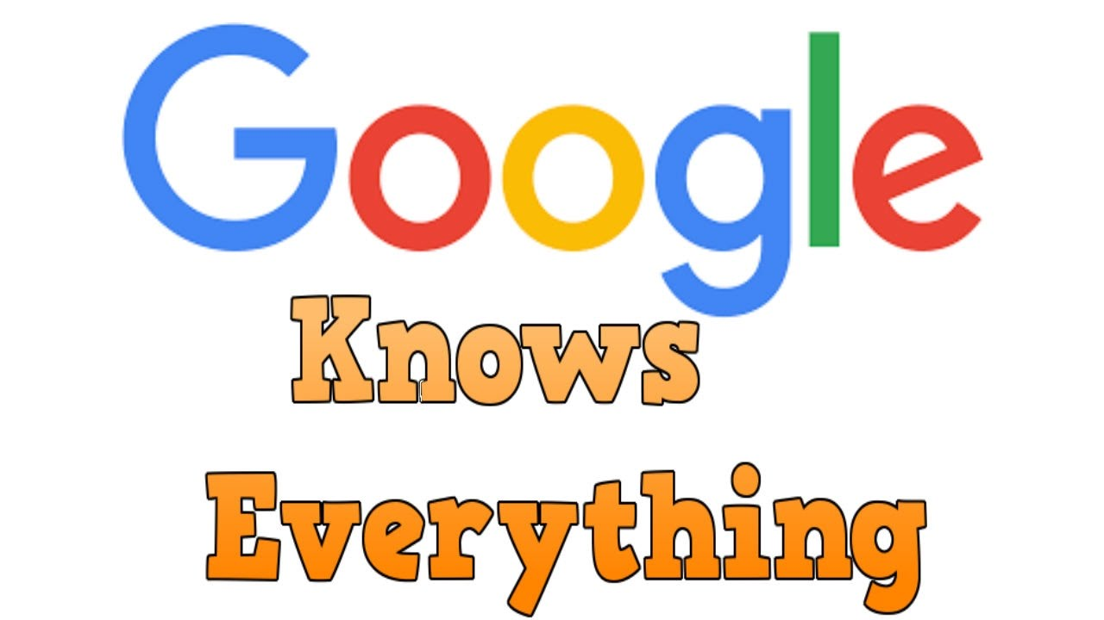
Eventually

Slide 21
There is an old saying, “If you give a man a fish you feed him for a day; teach a man how to fish and you feed him for a lifetime.” That is where education makes a difference.

Slide 22
Make the most of the opportunities.
Develop yourself and your skills and improve the quality of your life.

