Slide 1
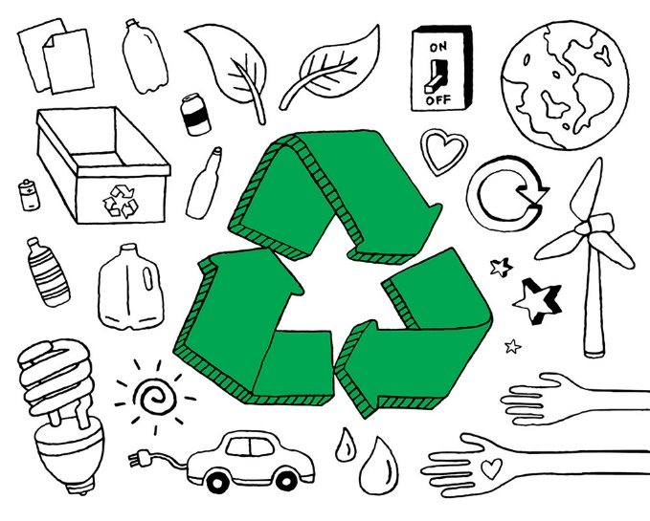
Eco-style life

Slide 2
«If humanity does not colonize space in the next thousand years, it will die out»
T. Hawking

Slide 3
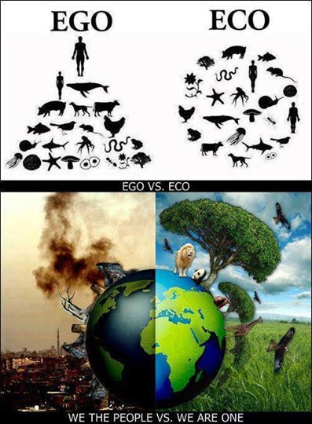
Waste, and how we choose to handle it, affects our world's environment—that's YOUR environment. The environment is everything around you including the air, water, land, plants, and man-made things. And since by now you probably know that you need a healthy environment for your own health and happiness, you can understand why effective waste management is so important to YOU and everyone else. The waste we create has to be carefully controlled to be sure that it does not harm your environment and your health.

Slide 4
What exactly is "waste?"
Waste is anything we throw away or get rid of, that doesn’t get used.

Slide 5
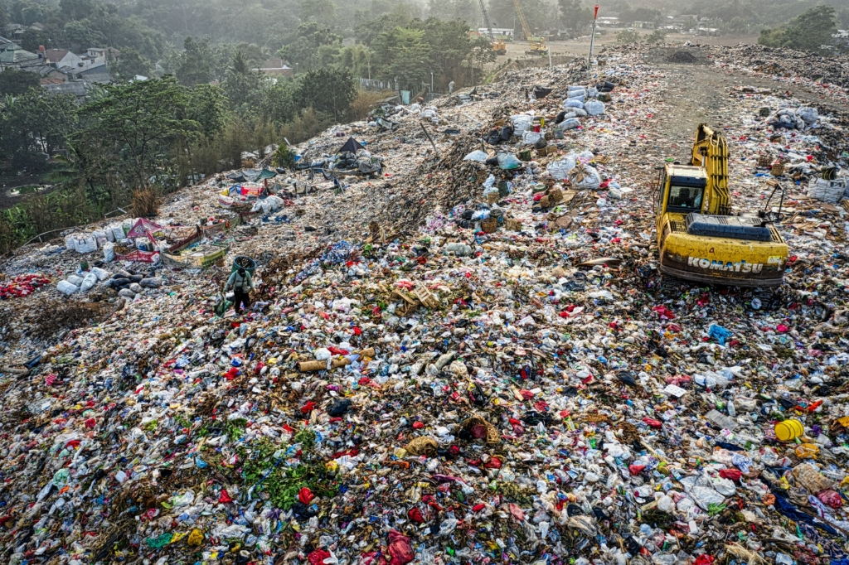
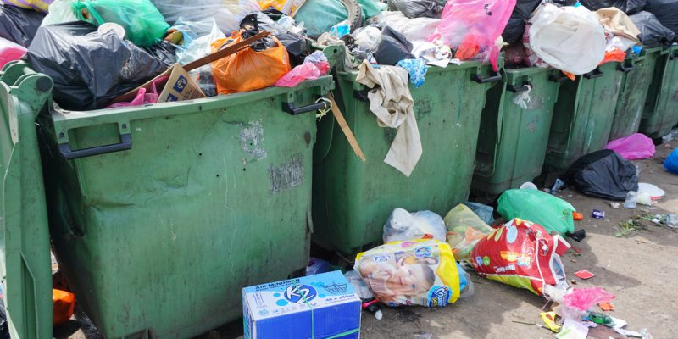

Slide 6
How can you help?
Three great ways YOU can eliminate waste and protect your environment!

Slide 7
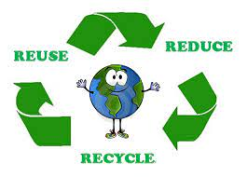
It makes a big difference to recycle. It makes a big difference to use recycled products. It makes a big difference to reuse things, to not use the paper cup – and each time you do, that’s a victory.
~ Emily Deschanel

Slide 9
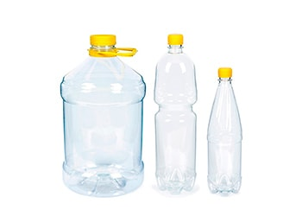
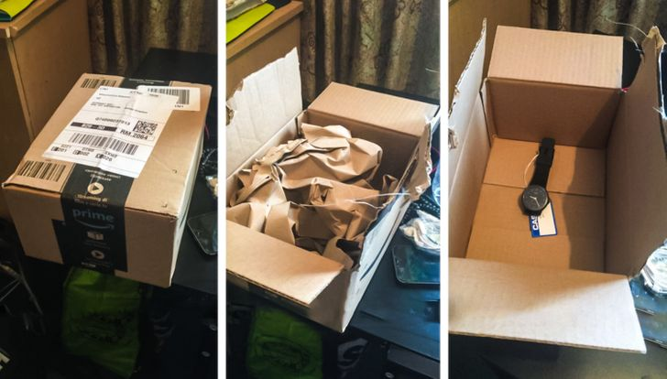
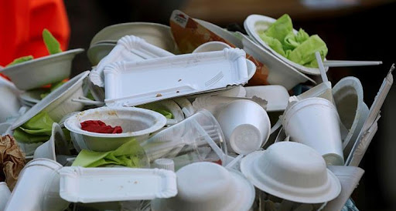
REDUCE: The best way to manage waste is to not produce it. This can be done by shopping carefully and being aware of a few guidelines:
Buy products in bulk. Larger, economy-size products or ones in concentrated form use less packaging and usually cost less per ounce.
Avoid over-packaged goods, especially ones packed with several materials such as foil, paper, and plastic. They are difficult to recycle, plus you pay more for the package.
Avoid disposable goods, such as paper plates, cups, napkins, razors, and lighters. Throwaways contribute to the problem, and cost more because they must be replaced again and again.

Slide 10
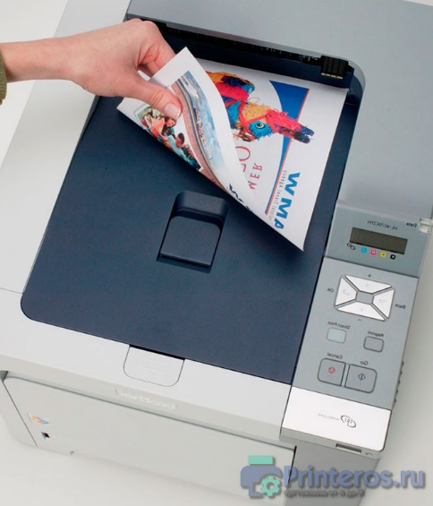
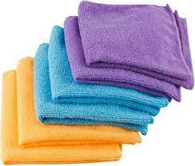
Buy durable goods – ones that are well-built or that carry good warranties. They will last longer, save money in the long run and save landfill space.
At work, make two-sided copies when ever possible.
Maintain central files rather than using several files for individuals.
Use electronic mail or main bulletin board.
Remove your name from the mailing lists of materials you no longer want to receive: write to Mail Preference Service, c/o Direct Marketing Assoc., P.O. Box 90008, Farmingdale, NY 11735.
Use cloth napkins instead of paper napkins.
Use a dish cloth instead of paper towels.

Slide 11
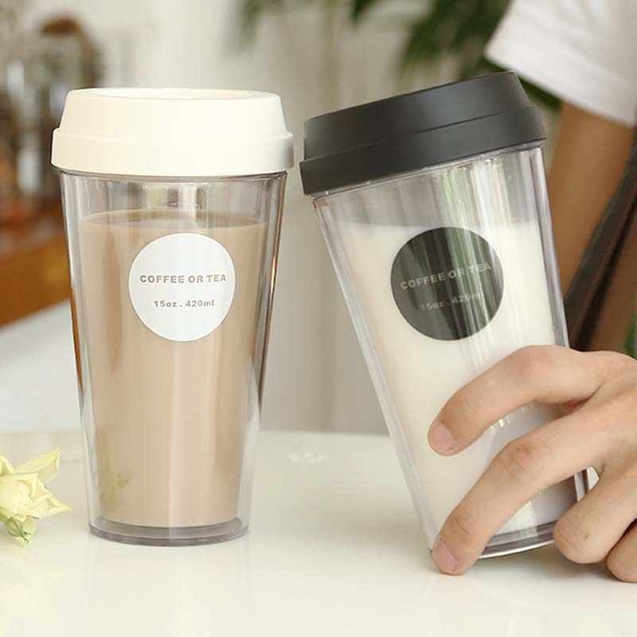
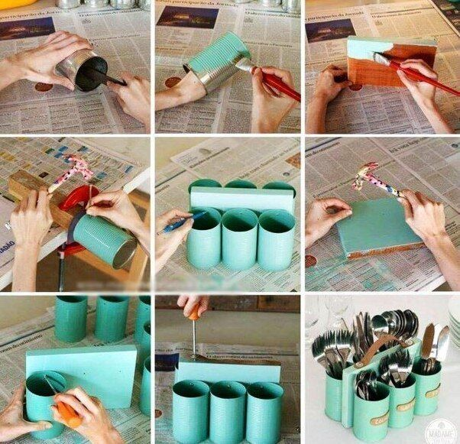
REUSE: It makes economic and environmental sense to reuse products. Sometimes it takes creativity:
Reuse products in different ways. Use a coffee can to pack a lunch; use plastic microwave dinner trays as picnic dishes.
Use a ceramic coffee mug instead of paper cups.
Reuse products for the same purpose. Save paper and plastic bags, and repair broken appliances, furniture and toys.

Slide 12
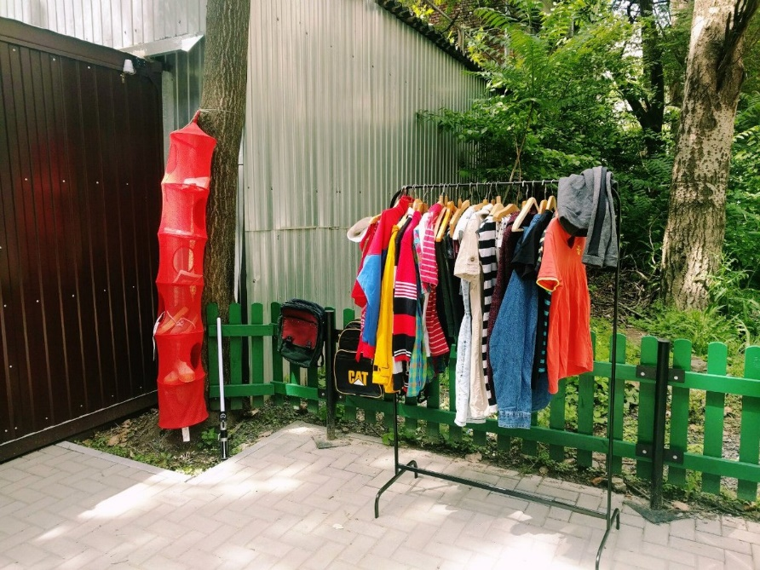
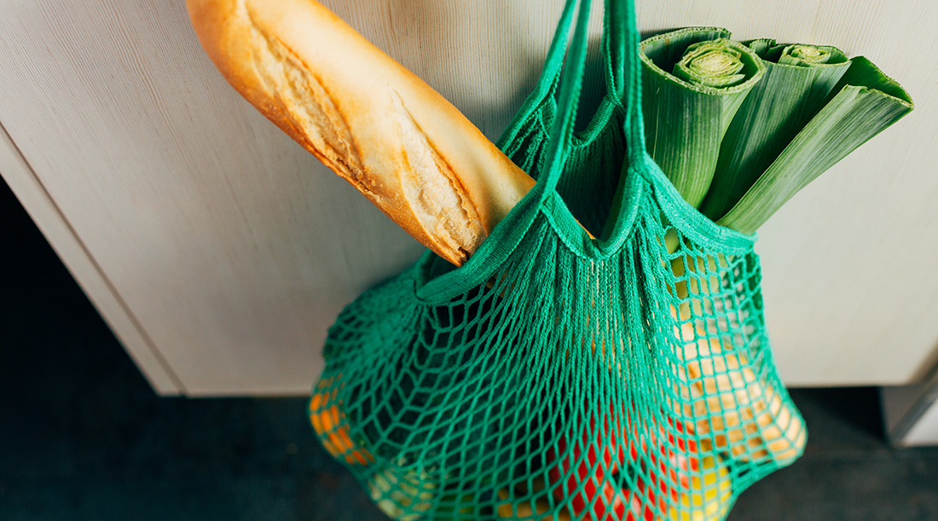
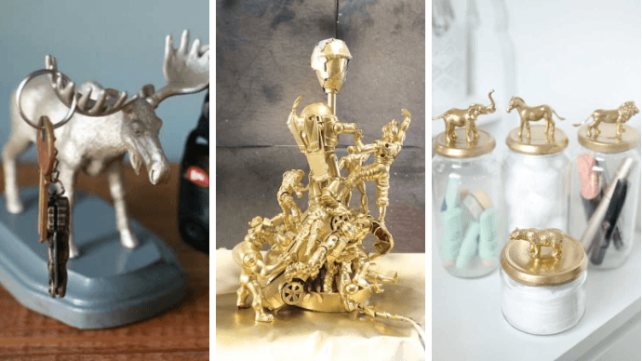
Sell old clothes, appliances, toys, and furniture in garage sales or ads, or donate them to charities.
Use reseal able containers rather than plastic wrap.
Reuse grocery bags or bring your own cloth bags to the store. Do not take a bag from the store unless you need one.

Slide 13
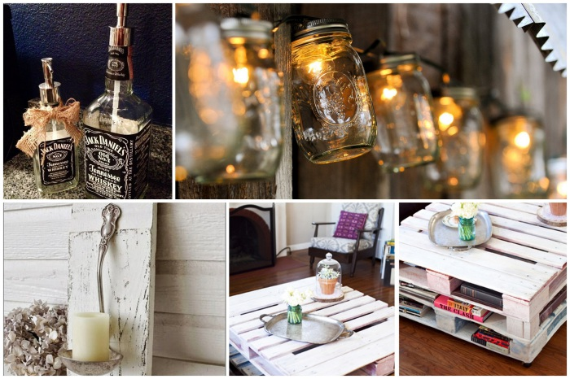
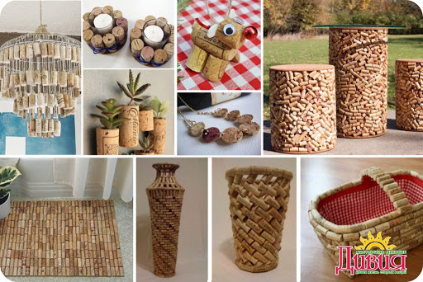
Ideas for your creativity

Slide 14
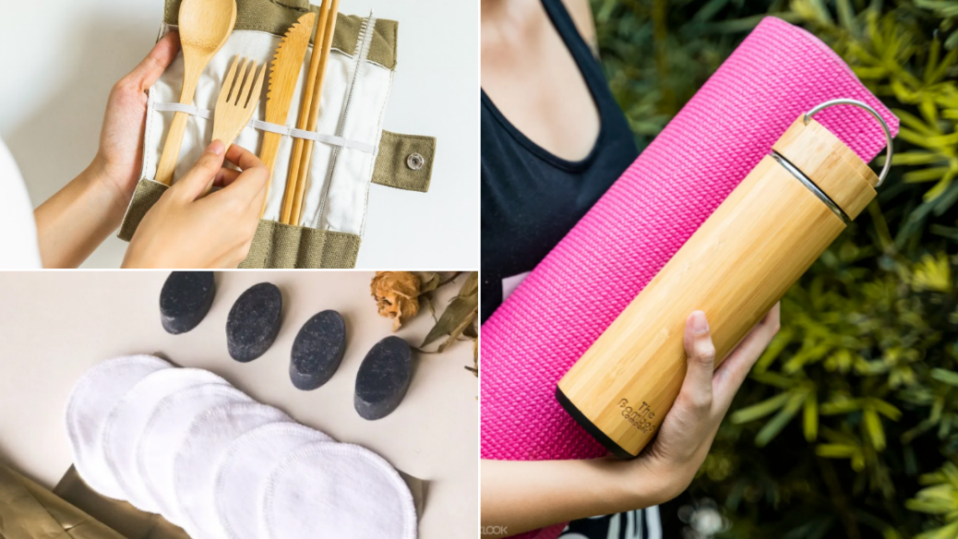
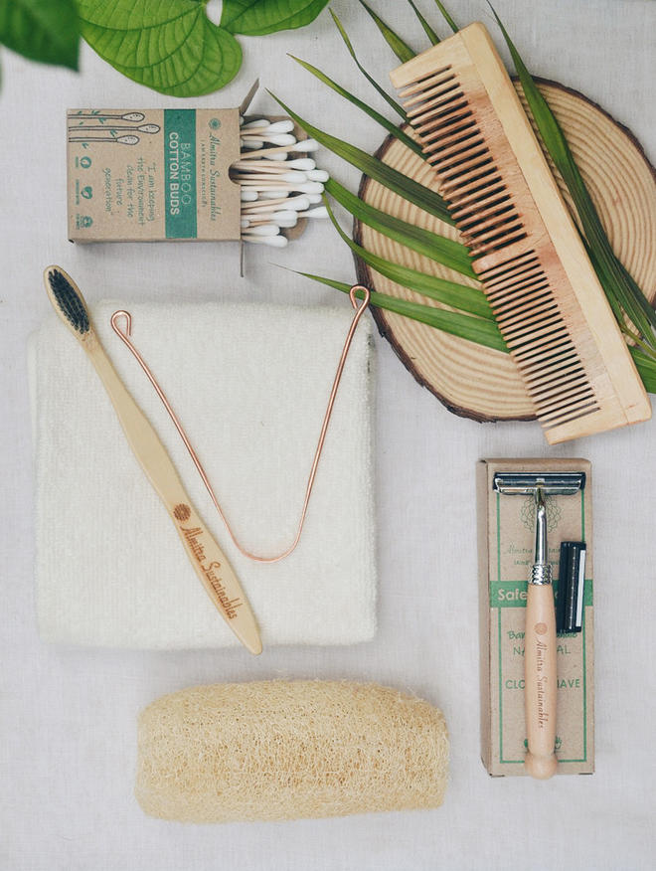
RECYCLE: Recycling is a series of steps that takes a used material and processes, remanufactures, and sells it as a new product. Begin recycling at home and at work:
Buy products made from recycled material. Look for the recycling symbol or ask store managers or salesmen. The recycling symbol means one of two things – either the product is made of recycled material, or the item can be recycled. For instance, many plastic containers have a recycling symbol with a numbered code the identifies what type of plastic resin it is made from. However, just because the container has this code does not mean it can be easily recycled locally.

Slide 15
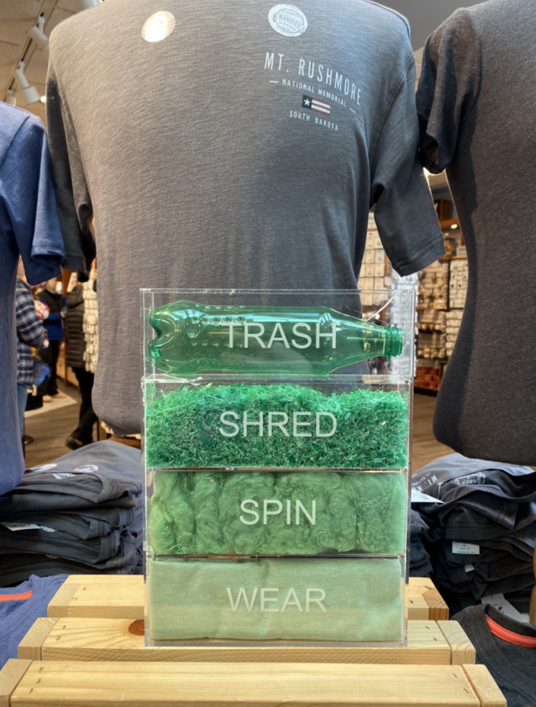
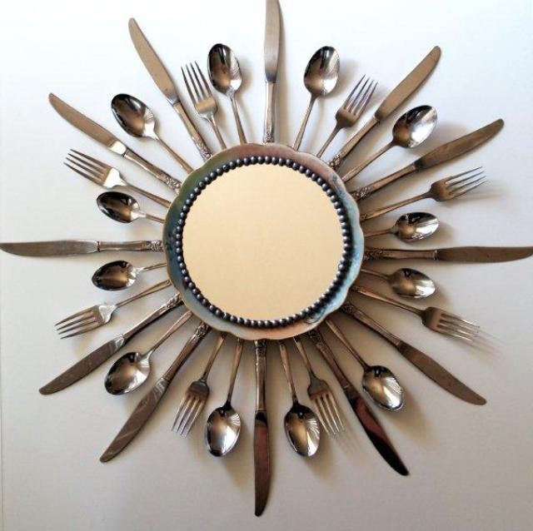
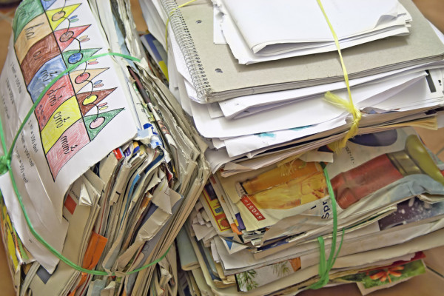
Check collection centers and curbside pickup services to see what they accept, and begin collecting those materials. These can include metal cans, newspapers, paper products, glass, plastics and oil.
Consider purchasing recycled materials at work when purchasing material for office supply, office equipment or manufacturing.
Buy products made from material that is collected for recycling in your community.
Use recycled paper for letterhead, copier paper and newsletters.

Slide 16
Idea
what can be done with old clothes?

Slide 17
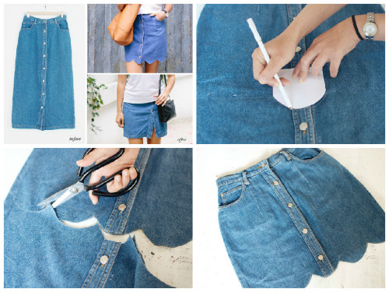
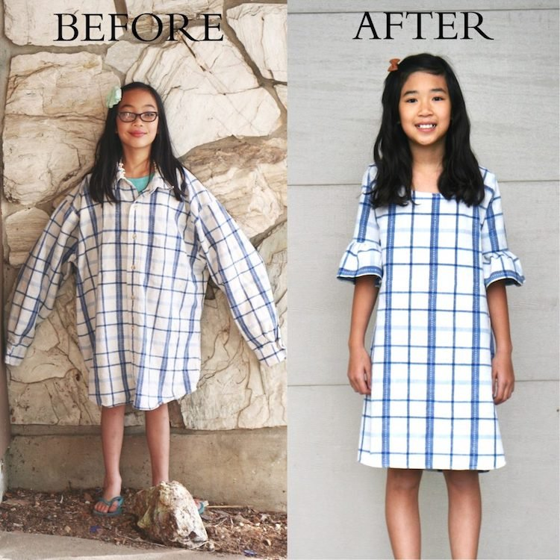
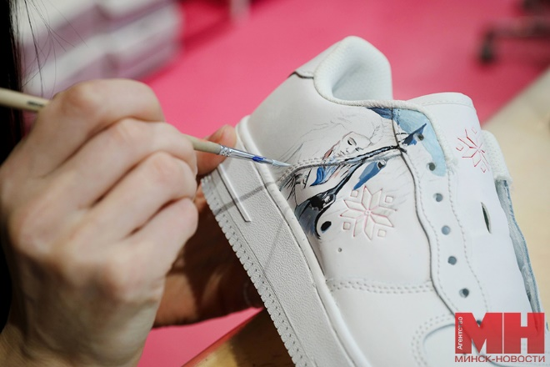

Slide 18
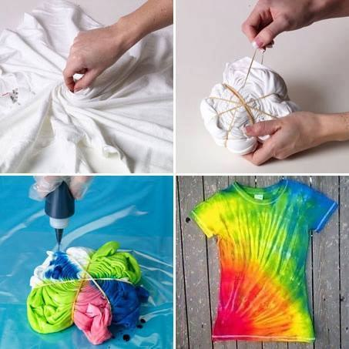
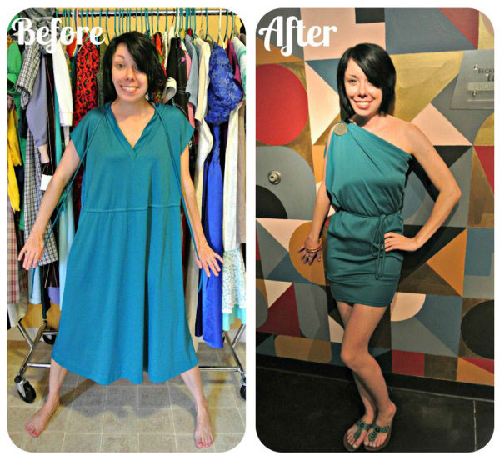
Main resource
is your ideas

Slide 19
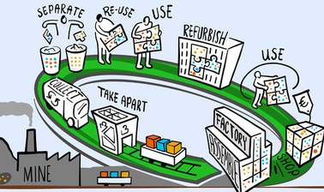
The 3 'R's – Reduce, Reuse, Recycle – are all about minimising the amount of waste we produce, reusing products as much as we can, and remembering to recycle any materials that can be used for a new purpose.

Slide 20
The scale of the challenges facing our planet can seem daunting, but we can all do something.

