Slide 1
Oxford University Press – publisher supporting libraries and research communities
Marcin Dembowski– marcin.dembowski@oup.com
April 2016
Grodno

Slide 2

The University of Oxford
Overview
The oldest university in the English speaking world.
It is a collegiate research based institution.
Notes:
The University is made up of a variety of institutions, including 38 constituent colleges and a full range of academic departments which are organised into four Divisions. All the colleges are self-governing institutions as part of the University, each controlling its own membership and with its own internal structure and activities.

Slide 3
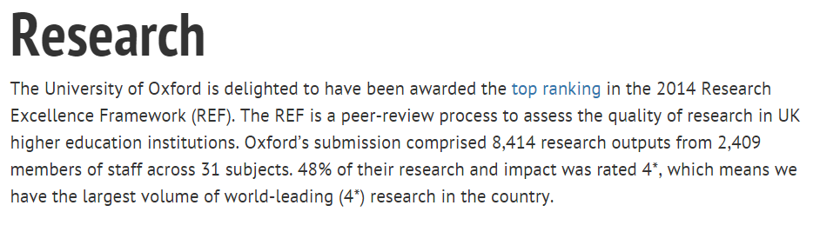

Oxford University and Research
Where does it rank?
Notes:
Result table - http://www.ox.ac.uk/research/research-impact/ref-2014-results/results-table
Summary of the results - http://www.ox.ac.uk/research/research-impact/ref-2014-results

Slide 4
Oxford University Press

Slide 5

Our Mission
Oxford University Press is a department of the University of Oxford. It furthers the University's objective of excellence in research, scholarship, and education by publishing worldwide.
John Fell
Clarendon Presentation—Tim Barton (November 2011)
Notes:
OUP is a department of the University.
Our mission is to further the University’s objectives of excellence…
The Press is overseen by a group of Delegates who are appointed from the university’s academic staff.
To give a sense of this special relationship: Delegates meet fortnightly, to review and approve projects.
That meeting is chaired by the Vice Chancellor (president) of the University.
Our chief executive, Nigel Portwood’s formal title is secretary to the Delegates.
Support the University’s mission by publishing the very best academic work, and high quality teaching materials. Both of which support education and the dissemination of knowledge
Other activities to support learning and literacy. For instance, run a major litareature festival each year in Karachi Pakistan
Our surplus on sales goes back to the university for projects and scholarships.

Slide 6
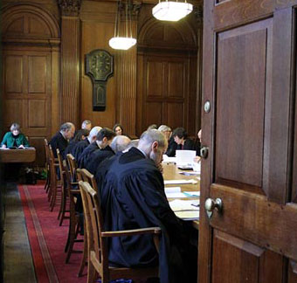

A Very Short Introduction
Origins date back to 1478
Largest university press
25th largest publisher in the world
6,000 employees worldwide
Over 5,000 titles per year, and 300 journals
Notes:
With origins dating back to 1478, when first book published at university
OUP is among the oldest university presses in the world
Picture of the delegates meeting in Clarendon building, where continuously meeting since 18th century.
Picture of the Press’s main office in Oxford
It is also the largest university press in the world
In fact, OUP is bigger than all other English language university presses in the world put together
Including the 110 UPs in the US, PLUS Cambridge.
Employ 6,000 people worldwide with major publishing offices in Oxford, New York, and Dehli.
Publish close to 7,000 new titles each year, 300 journals, and a range of online products.
Publish in more than 40 languages, and in a variety of formats– print and digital.
Sell more than 110 million units each year, and most of those sales are outside of the UK.
OUP accounts for 55% of the University Press market.
While giant by university press standards, we are a mid-sized publisher within the wider industry.
According to a global ranking of the Publishing industry, we’re the 25th largest.
About $1 billion in sales per year.

Slide 7
Oxford University Press
Products

Slide 8
Support to Students Researchers and Academics
OUP in Humanities
Reference Materials
ODO, OBO, ORO
Framing the question for exploration & reflection
Scholarly Resources
OHO, UPSO, Journals, Research Encyclopaedias
Build argument & Support with evidence
Topic
Oxford Index
Generating related OUP content to deepen your search
Notes:
Linking our material to a research journey where each of them falls under one category.
The reference material would be: ODO, OBO, ORO
The Scholarly Resources: OHO, UPSO, Journals
The subject specific will vary between reference and scholarly resources because they cover both aspects based on their content.

Slide 9








Slide 10




Presentation Outline
Online Dictionaries

Slide 11
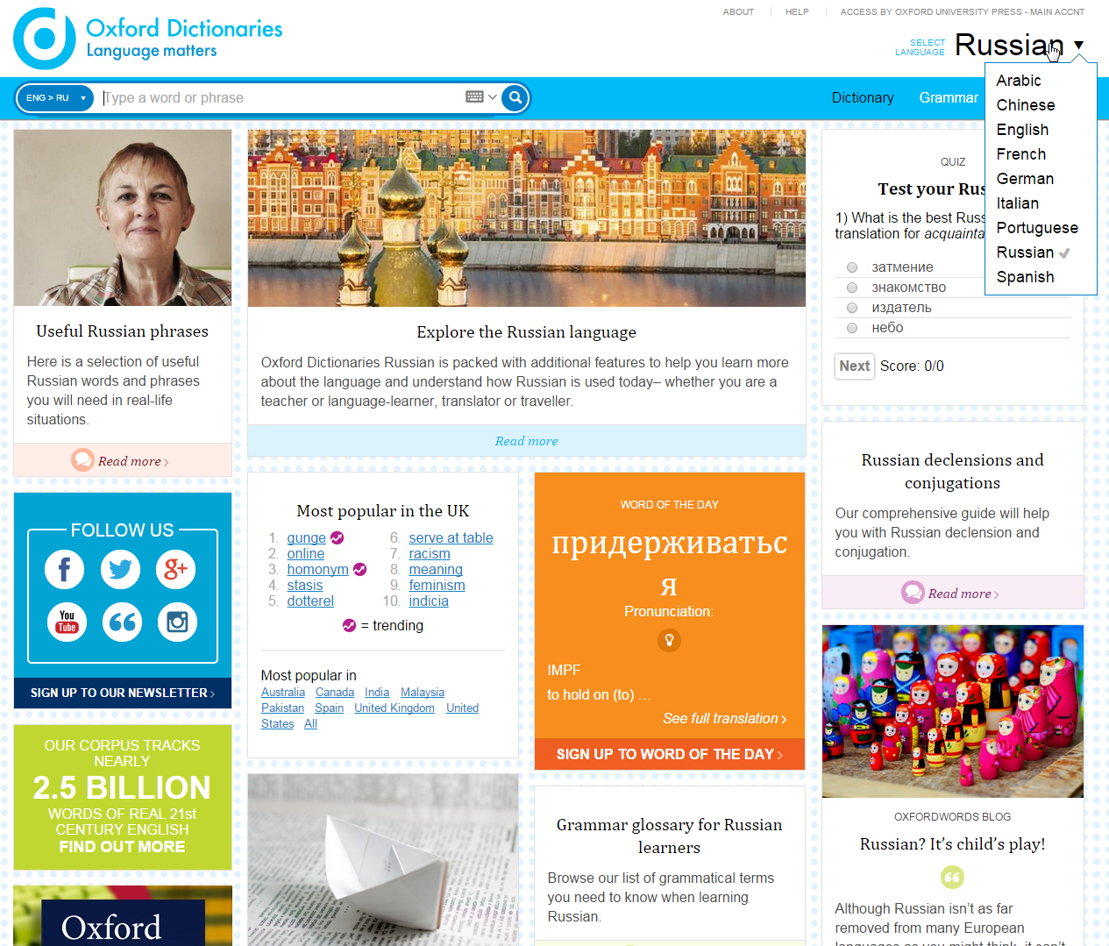
Oxford Dictionaries
If you are learning English as a second
language or wish to expand your
knowledge in Russian, you will be able
to:
*Look at the Explore section to learn more
about writing, the holidays of the country
*You will be able to hear the pronunciation of
words and sentences
*You will be able to transliterate i.e.
type Arabic with Latin characters and the
dictionary recognises the Arabic equivalent
The dictionary re-launched with adding
Russian and Chinese to its content
The introduction of Portuguese as a new
joiner to the site
The increase of the information and
definition within the French, Spanish,
Italian, and German languages
Explore the content
Notes:
1- The dictionary relaunched a week back with adding Russian, Chinese to its content
2- The introduction of Portuguese as a new joiner to the site
3- The increase of the information and definition within the French, Spanish, Italian, and German languages
4- If you are learning English as a second language or wish to expand your knowledge in Russian, you will be able to:
*Look at the Explore section to learn more about writing, the holidays of the country
5- You will be able to hear the pronunciation of words and sentences
6- You will be able to transliterate i.e. type Arabic with Latin characters and the dictionary recognises the Arabic equivalent

Slide 12
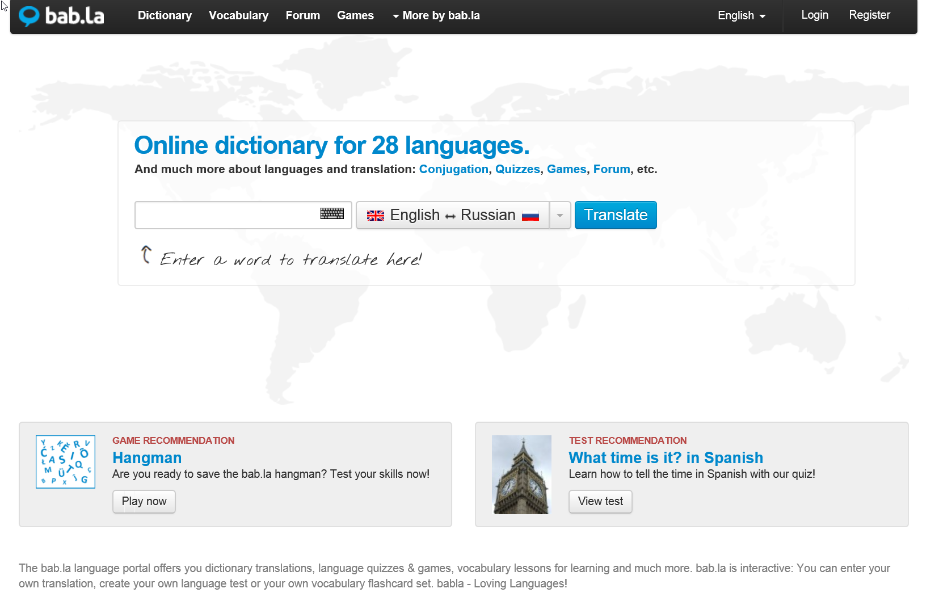

Slide 13
Oxford Journals
Supporting Researchers and Research Communities

Slide 14
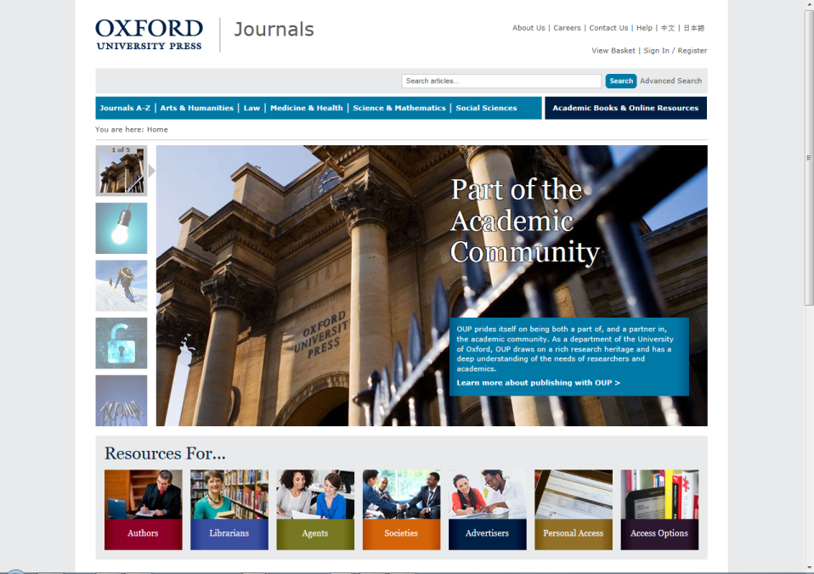
Oxford Journals Collection – коллекция журналов OUP, представляет авангарду мировых академических исследований являясь бесценным источником информации для пользователей online, научных сотрудников, библиотек.

Slide 15

Более 2/3 оксфордских журналов публикуется совместно с научными товариществами. Этому сотрудничеству свойственна научная и географическая многопрофильность.

Slide 16
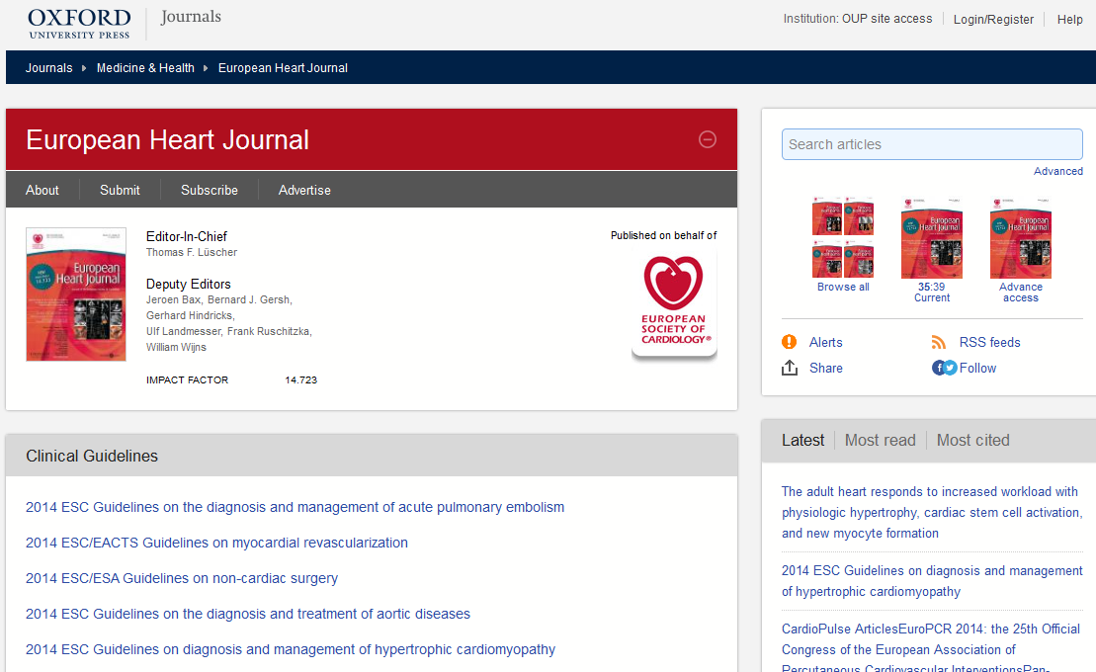
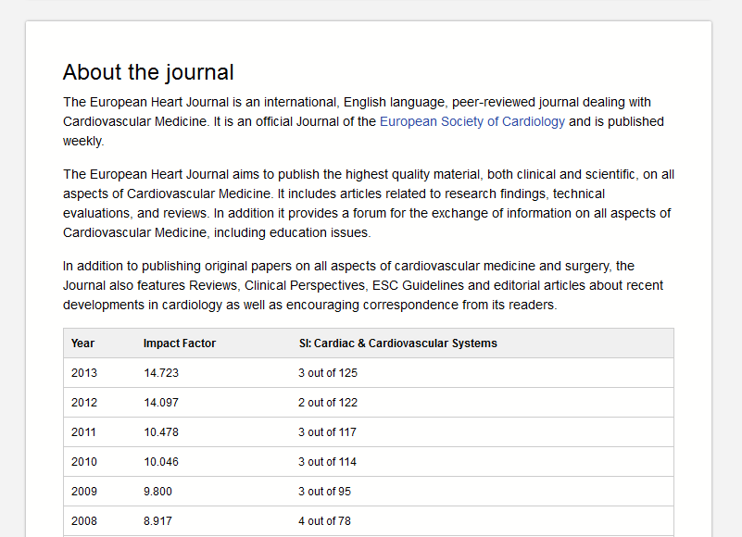
Неотъемлемой частью нашей научной миссии является публикация высочайшего качества журналов - факт, неоднократно отмеченный рейтингами Impact Factor – показателями престижа и воздействия.

Slide 17
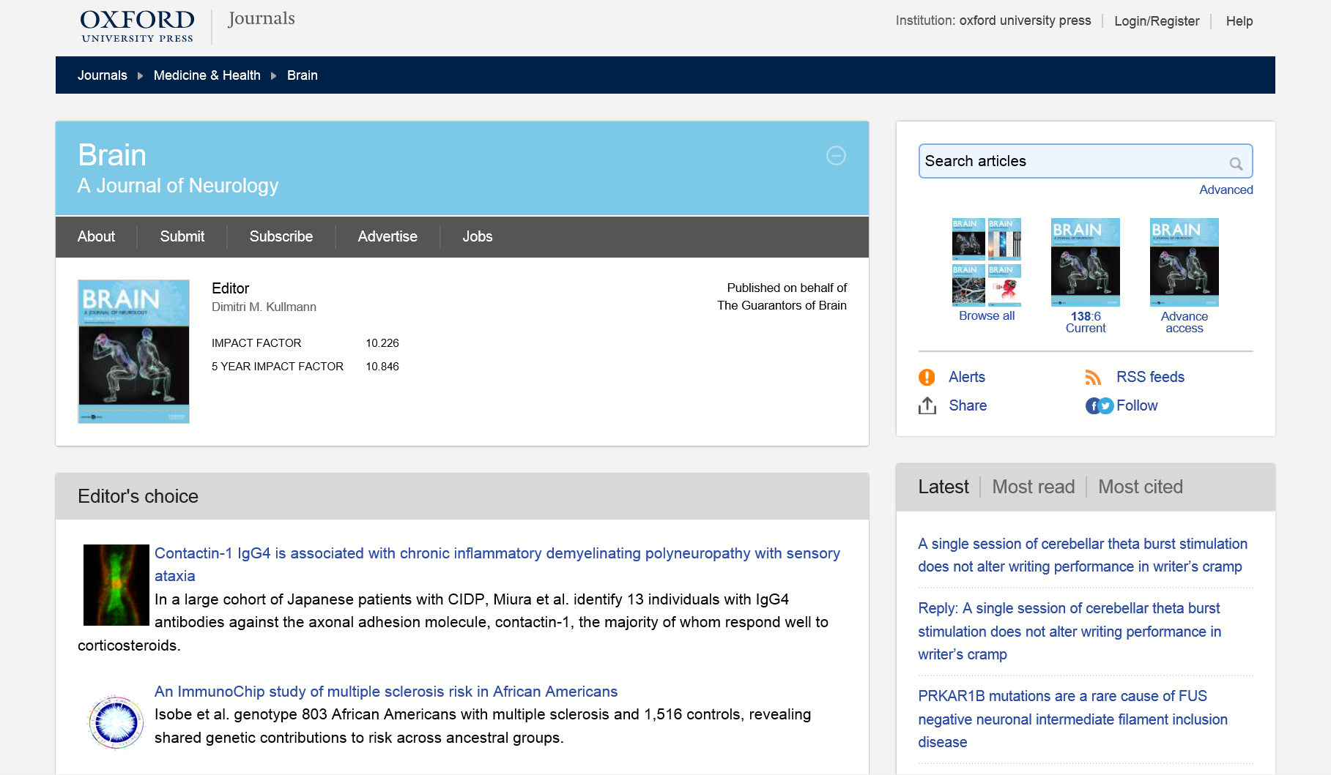
Все журналы доступны на мобильных устройствах.

Slide 18

Medicine Collection 2015
Free content

Slide 19
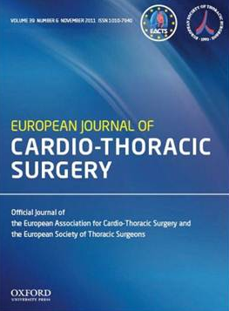
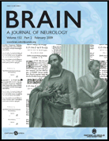
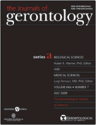
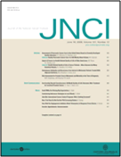

The Medicine Collection – 87 journals
  Oncology, cardiology, neurology, epidemiology, reproductive medicine, rheumatology, anesthesia, gerontology, & public health

Slide 20
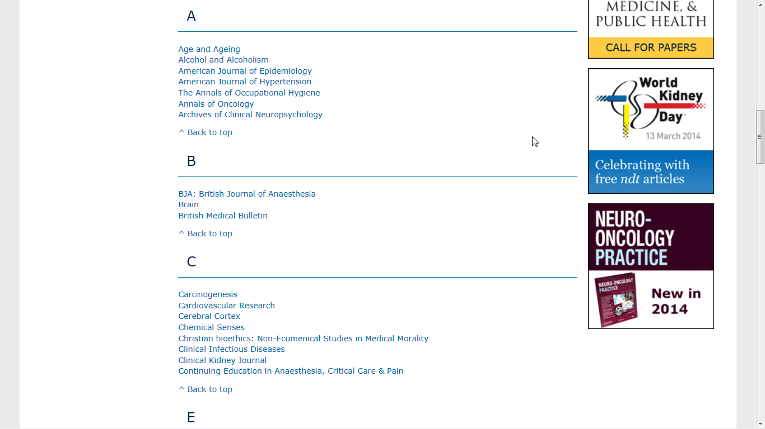
Medicine & Health

Slide 21
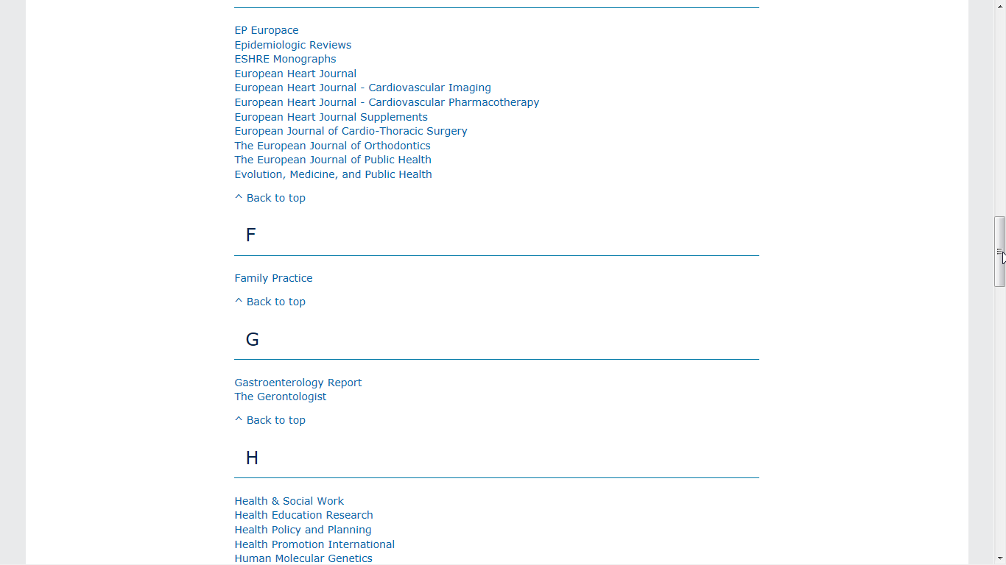
Medicine & Health

Slide 22
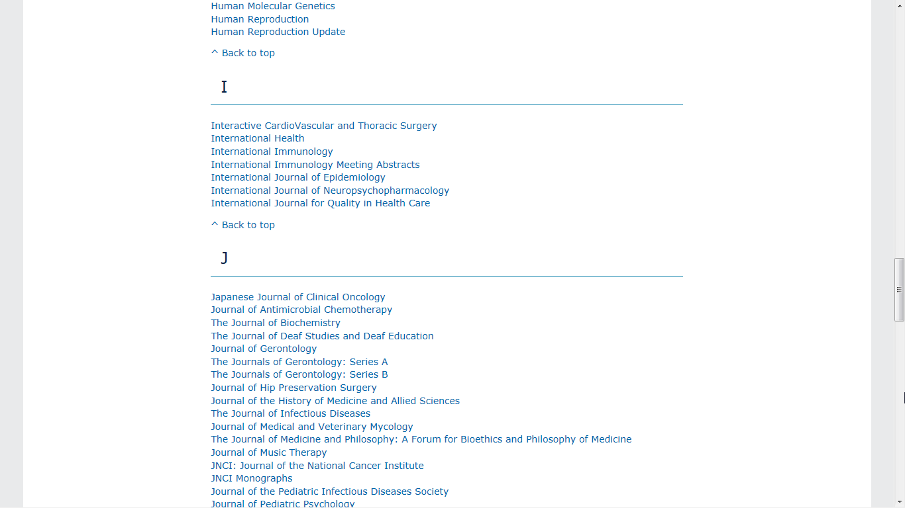

Slide 23
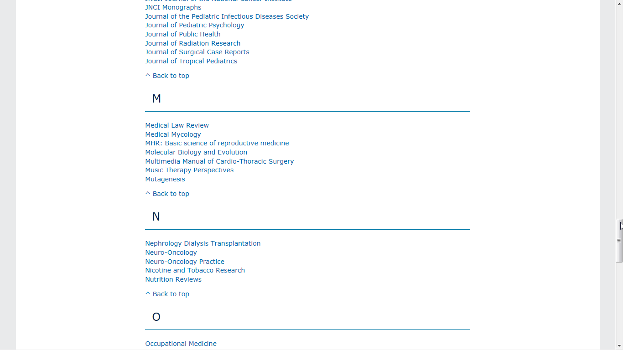

Slide 24
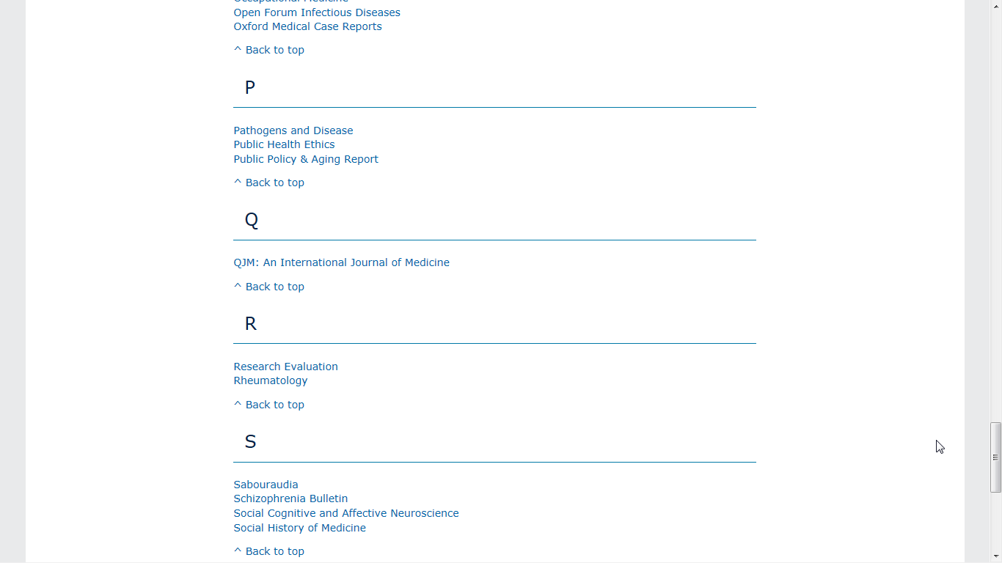

Slide 25
Oxford’s Specialised Platforms
Oxford Medicine Online

Slide 26

www.oxfordmedicine.com
www.oup.com

Slide 27

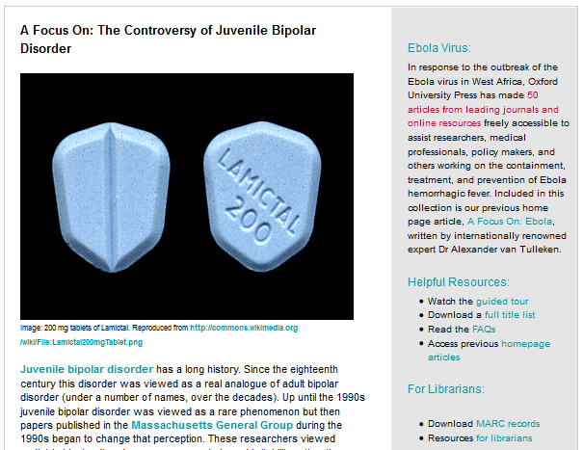
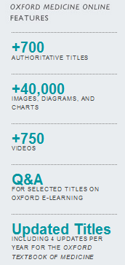

Slide 28
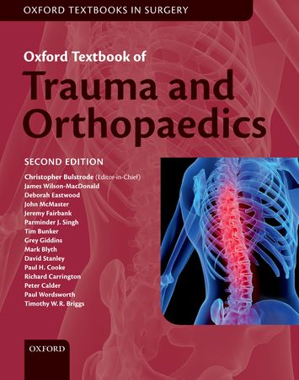
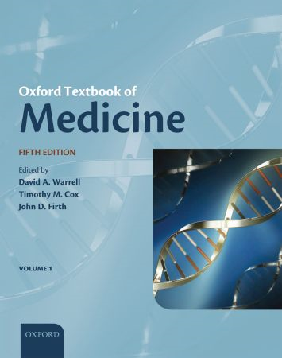
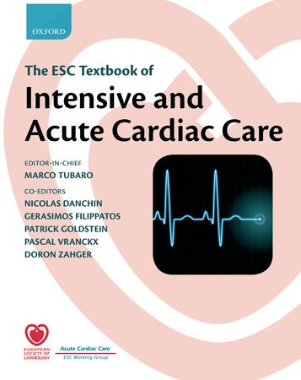
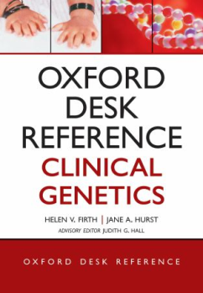


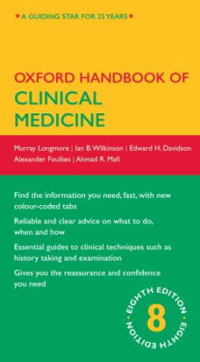
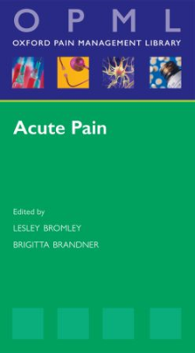
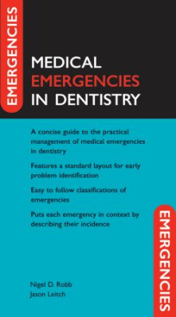
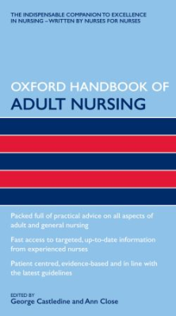
Oxford Medicine Online
What does it contain?
Online versions of OUP’s print medical content
Medical Textbooks Medical Handbooks

Slide 29


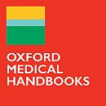

Oxford Medicine Online
Platform to access and search all practical medical content.
Oxford Medical Handbooks Online (100+ Medical, Emergencies In, and Nursing titles) for the medical student, trainee doctor or nurse. Designed to assist students or new professionals with key practical advice and concise content.
Oxford Medical Libraries Online in 13 specialty collections (77 titles) for medical professionals in hospitals. They give summarized advice, the latest research and drug treatments.
Oxford Specialist Handbooks Online in 10 collections (73 titles). Key information to successfully train in medical and surgical sub-specialties.

Slide 30
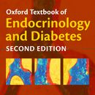
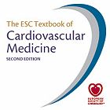

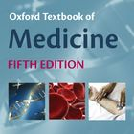
Oxford Medicine Online
Oxford Medical Textbooks Online. 28 essential textbooks across medical specialties for consultants.
Oxford Desk References Online. 10 medical reference titles for more in-depth use by medical practitioners for the latest evidence-based guidelines and current best practice. Brings together content found across websites, journals and books.
European Society of Cardiology Textbooks. Three textbooks for trainee and practising cardiologists.
Oxford Textbook of Medicine. 600 chapters on basic science & clinical medicine. The essential companion for the medical consultant. Trusted, comprehensive coverage on the practice of medicine across the world.

Slide 31
Oxford Medicine Online
Who is it for?
Senior Doctors & Consultants
Medical Students, Junior Doctors, trainee and qualified Nurses

Slide 32
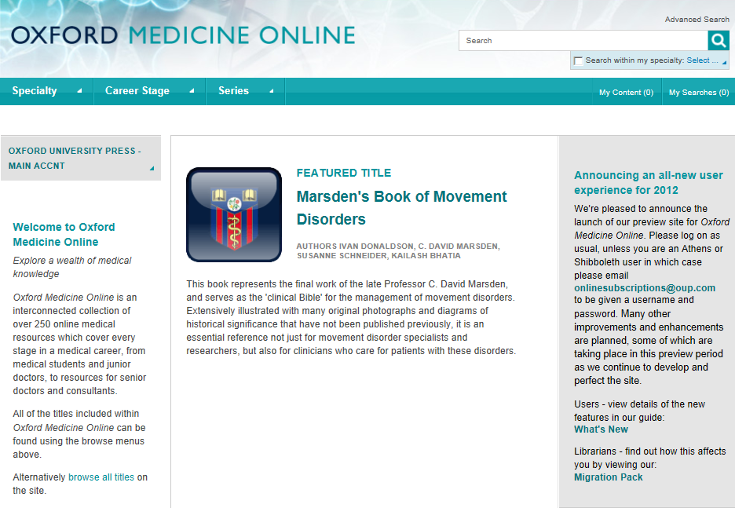
Oxford Medicine Online, возобновлённый летом 2012, является взаимосвязанной XML-коллекцией онлайн-ресурсов по медицине, охватывающей все этапы медицинской карьеры.
Портал предоставляет доступ к высококачественному, проверенному медицинскому контенту, незаменимому для всех медицинских работников, которым нужна достоверная информация без задержек.

Slide 33
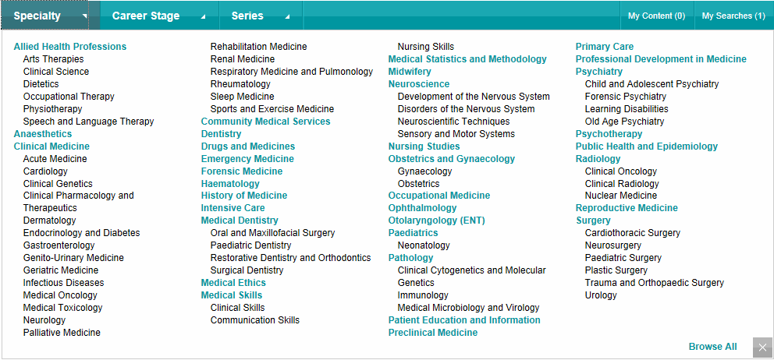

Контент организован в виде коллекций в соответствии с медицинскими специальностями...

Slide 34
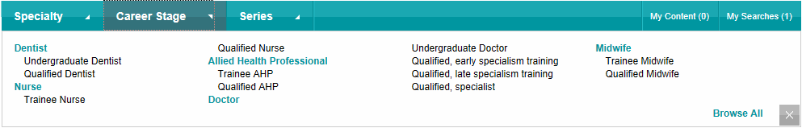
…этапами карьеры…

Slide 35
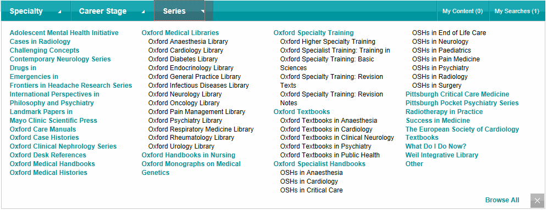
…и сериями.

Slide 36
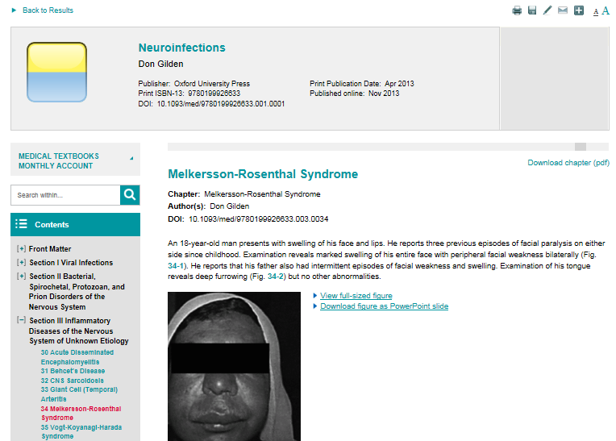
Значки вверху позволяют распечатывать контент, сохранять его в персональном разделе, экспортировать цитаты в соответствующие программы, посылать ссылки на статьи по почте и размещать их в социальных сетях.
Обратите внимание, что главы можно скачивать в PDF-формате.

Slide 37
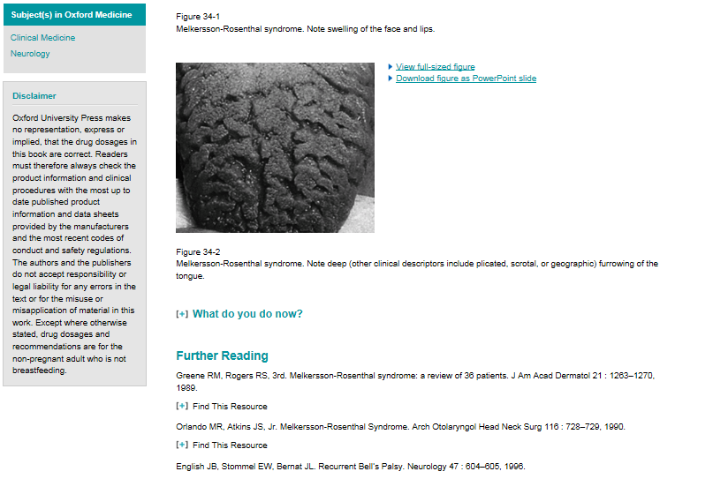
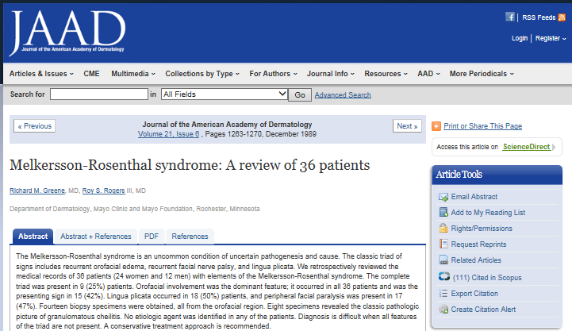
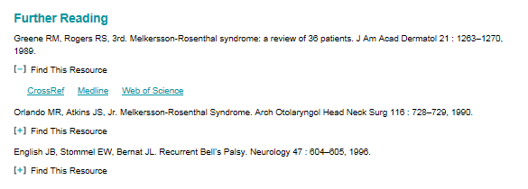
Дополнительная литература в нижней части главы позволит расширить исследования.

Slide 38
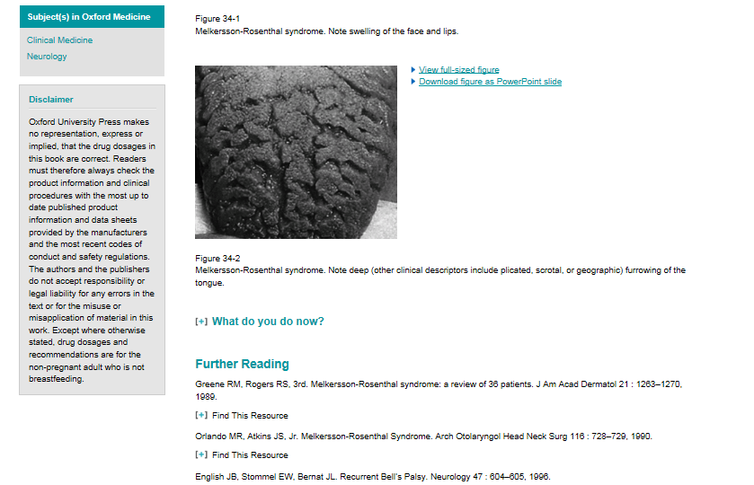
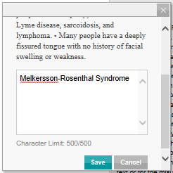
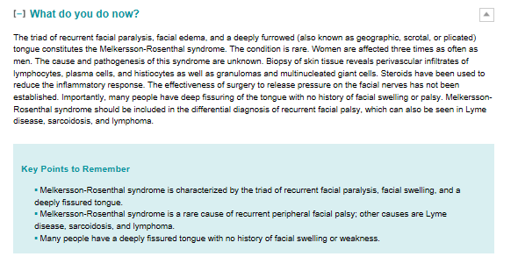
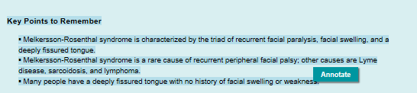
Вы можете также комментировать текст, а также увеличивать и загружать изображения в Power Point для лекций и презентаций.

Slide 39

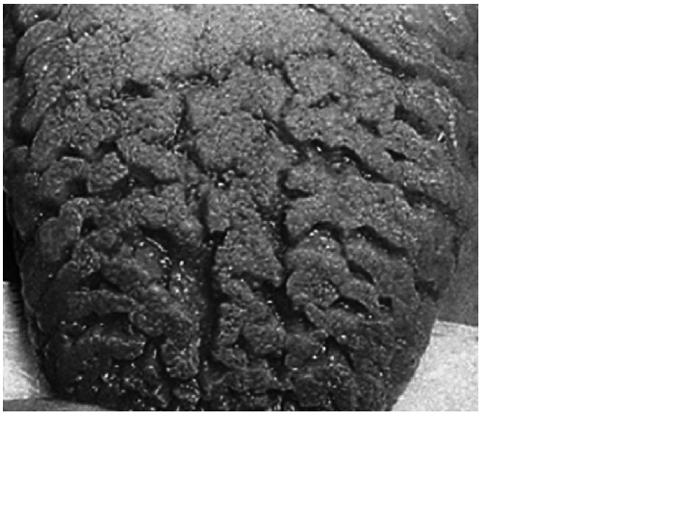
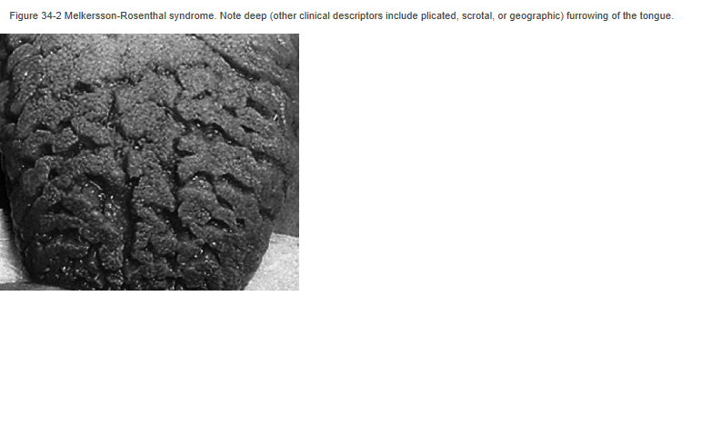

Slide 40
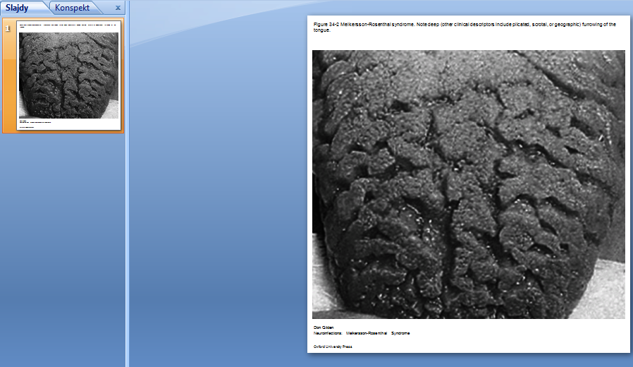

Slide 41
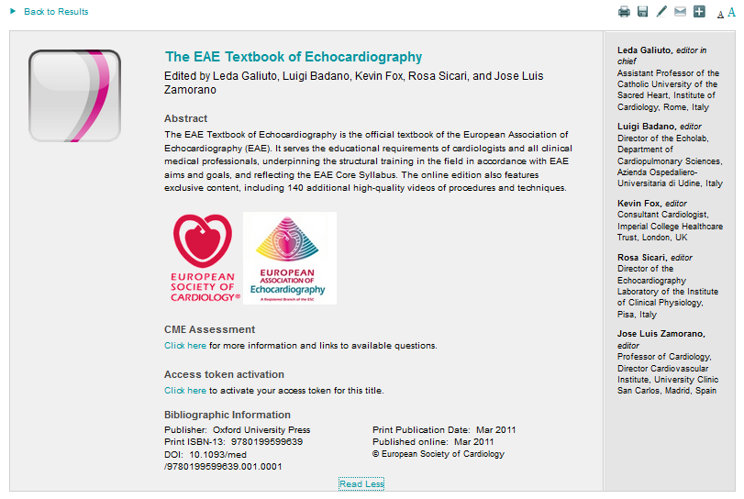

Slide 42
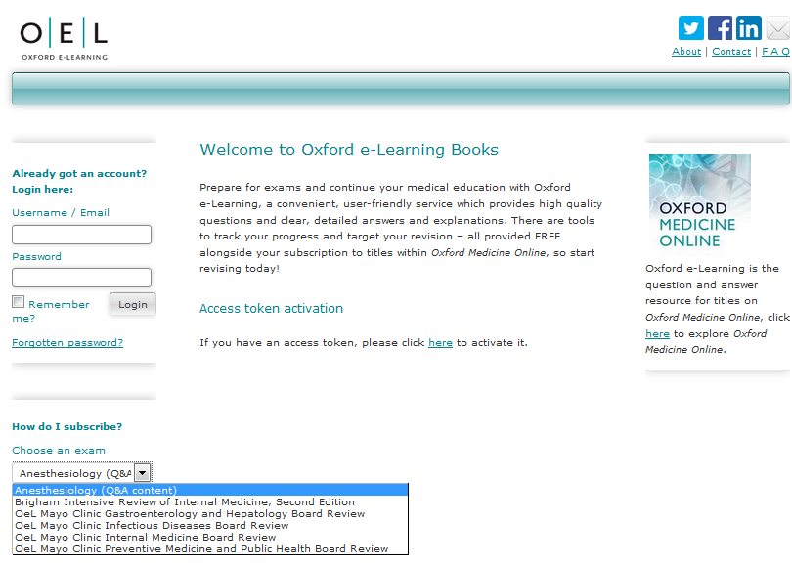
Oxford e-Learning является вспомогательным ресурсом с вопросами и ответами для изданий из Oxford Medicine Online

Slide 43
Oxford E-Learning
В OEL вы найдёте:
- отобранные издания для вашего обучения
- тесты
- результаты тестов
- анализ результатов теста
Обратите внимание, что вы также можете распечатать сертификат, подтверждающий ваши достижения на основе данного материала

Slide 44
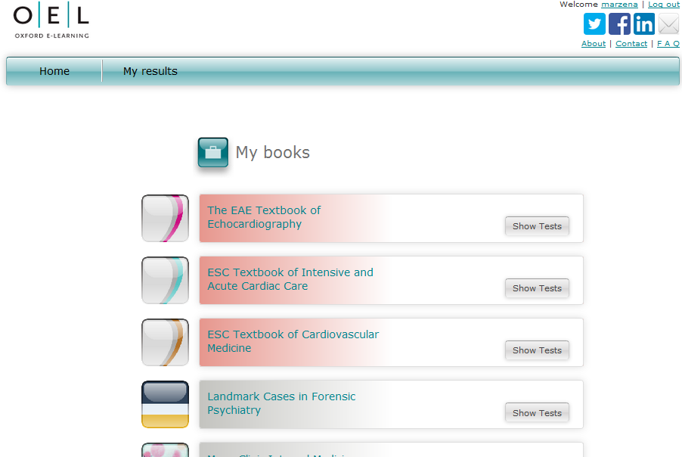
Inside OEL

Slide 45
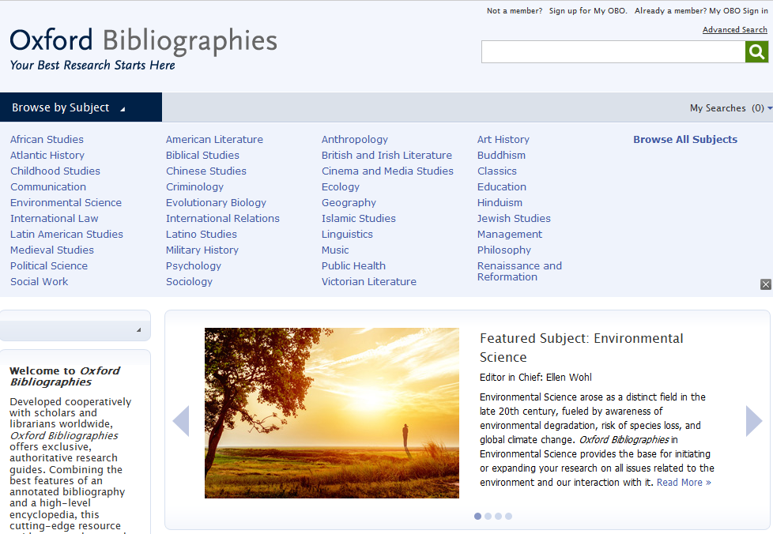
Каждая тема в Oxford Bibliographies объединяет обширную коллекцию статей, касающихся разделов той или иной дисциплины.
В результате получился невероятно мощный новый ресурс, разработанный, чтобы послужить исследователям путеводной нитью в ситуации информационной перегрузки.
Oxford Bibliographies разработан совместно с учёными и библиотекарями из разных стран и содержит эксклюзивные, авторитетные пособия для исследований.

Slide 46

Каждая статья в Oxford Bibliographies снабжена прямыми рекомендациями и контекстной информацией, чтобы пользователи могли найти в точности те ресурсы, которые им нужны.

Slide 47

Каждая статья, написанная и отрецензированная ведущими учёными в своих областях, состоит из вводного текста и комментариев с последующим аннотированным списком ссылок на процитированные работы:

Slide 48

Значки OpenURL ведут на запись соответствующего ресурса в вашем библиотечном каталоге
Ссылки WorldCat приводят прямо на запись соответствующего ресурса в каталоге OCLC WorldCat.
Ссылки Google Books (где это возможно) ведут прямо на этот ресурс в Google Books.

Slide 49

заголовки – определяют типы ресурсов и основные научные области
Экспертные комментарии вводят в контекст и дают рекомендации, ориентируя пользователя среди цитат
Ссылки на ресурсы, доступные в вашем библиотечном каталоге, OCLC WorldCat, Google Books и т.д.
Цитаты снабжены выборочным списком лучших и наиболее полезных ресурсов
Аннотации показывают, что включено в работу, и дают указания о том, как ресурс может способствовать поиску

Slide 50


Slide 51
Which Areas Are Covered?
A Selection
Addictive and Substance Use Disorders
Anxiety Disorders
Attention Deficit Hyperactivity Disorders (ADHD)
Eating Disorders
Obsessive Compulsive Disorder (OCD)
Sleep Disorders
Trauma

Slide 52
Who Is Oxford Clinical Psychology
Aimed at?
Lecturers and Professors
Researchers
Students
Therapists

Slide 53
“Treatments That Work”
Trusted Series among Behavioural Therapists
Evidence-based
85 Titles
Titles for both Clients and Therapists: Workbooks und Therapist’s Guides
Editor: Dr. David Barlow
Checklists and Worksheets can easily be edited offline (but need to be saved first)

Slide 54

Discoverability
Search across 2.5 million abstracts from Oxford University Press – scholarly essays, journal articles, and reference works
Freely available abstracts make discovery of Oxford’s content via Google and other search engines easier
Overview pages with links to additional resources

Slide 55
How to get published with international journals?

Slide 56

Before you start………….
You must have a clear topic
or topics to be reviewed,
what is your research
question?

Slide 57
Ideas where to start
As well as ‘traditional’ research…
Are you working on a Doctoral or Master’s thesis?
Have you completed a project which concluded successfully?
Are you wrestling with a problem with no clear solution?
Do you have an opinion or observation on a subject?
Have you given a presentation or conference paper?
If so, you have the basis for a publishable paper

Slide 58

Editors are looking for “something new and preferably surprising” according to Dr. Peter Smith, a Cambridge philosopher and former editor of Analysis, the philosophical journal.
NEW IDEAS
NEW IDEAS
NEW IDEAS

Slide 59
Be Careful:
There are 1,000,000’s of published studies. You need to MASTER your topic: be aware of works completed by others, updates or/and be ready to answer questions or summarize it.

Slide 60


References:

Slide 61
Oxford Bibliographies Online
OBO is a library of discipline-focused, online guides to the essential literature across a broad range of subject areas.
Each OBO article, written and reviewed by top scholars in the field, is rich with citations and annotations, expert recommendations, and narrative pathways through the most useful and important works on the topic in question.
Intuitive linking throughout quickly delivers the user from a citation to full-text content, whether online or available through a library’s catalog.
“We are drowning in information, while starving for wisdom. The world henceforth will be run by synthesizers, people able to put together the right information at the right time, think critically about it, and make important choices wisely.”
— E.O. WILSON
Notes:
Quote from Edward Osborne Wilson Harvard University professor and 2 time winner of the Pulitzer prize.
27 subject areas available; launching 10-12 new subjects each year
Every subject area has an Editor-in-Chief and Editorial Board, and each article receives multiple peer reviews and board vetting
50-100 articles at launch per subject (equivalent to a 4-volume print encyclopedia)
Updated regularly, with 50-75 articles added per year to each subject area. Updates will also include revisions to existing articles.
It is selective, rather than exhaustive; expert recommendations with critical supportive text and annotation are provided to help cut down on time needed for preliminary research
Articles contain recommendations for scholarship at all levels, from encyclopedias and textbooks to journal articles and data sets – whether you’re starting a research paper, studying for qualifying exams, or preparing a syllabus, OBO is the perfect starting place
Includes indexing of non-print material, especially online resources

Slide 62

Our Focus

Slide 63
Initial literature review: The 5 X 5 principle
Identify 5 top peer refereed academic journals focusing on
your specific subject
Identify 5 top internationally recognized books or collective
works on your specific subject
Identify 5 top academic research centres specializing in
your subject
Identify 5 most renowned professors in your narrow field
(„gurus”)
Identify 5 top regular international academic conferences
covering your subject

Slide 64

Think of a literature review as a jigsaw puzzle

Slide 65


Slide 66


Slide 67


Slide 68

Which journal to go for?

Slide 69
Criteria You Might Look At:
Rankings (example Thomson Reuters Impact factors; the Association of Business Schools ABS etc.)
Number of downloads (utility)
Dissemination of journal (where it is read)
Links to societies/associations
Relevance of content and publishing ethos
International

Slide 70
Questions to Ask Yourself
When Choosing:
What are your most important factors when choosing a journal?
Which resources do you use to research the journals you publish in?
Which rankings do you use? How important are they?
Who do you ask for advice?
What is the best journal in your field? Why?

Slide 71

PROCESS!!!!!
Putting A and B together to build up your work

Slide 72
Surviving peer review
Not always straight forward proccess

Slide 73

Research is all about peer review
You need to avoid a desk reject
You may need to revise and resubmit
You will almost certainly need to alter your paper

Slide 74
The Process
Submission is an important step on the road to being published
Reviewers are selected for their expertise by the Editors
They do sometimes make mistakes and their opinions may not be valid
But generally they raise genuine concerns about the work – conceptualization, execution and/or interpretation of the work

Slide 75
The Process
Their comments are aimed at maintaining the quality of papers publish in the journal, the overall journal reputation and ultimately at improving your work to attain a high standard of academic writing.

Slide 76
Process Conclusion:
Identify a few possible target journals but be realistic
Follow the Author Guidelines: scope, type of paper, word length, references style, etc.
Find where to send your paper (editor, regional editor, subject area editor) …
… and how to send it (email, hard copy, online submission)
Send an outline or abstract to editor: is it suitable? how can it be made so?
Read at least one issue of the journal

Slide 77
www.oxfordjournals.org

Slide 78


Slide 79
www.oxfordjournals.org

Slide 80


Slide 81


Slide 82


Slide 83


Slide 84


Slide 85
What makes a good paper?
HINT: Editors and reviewers look for …
Originality – what’s new about subject, treatment or results?
Relevance to and extension of existing knowledge
Research methodology – are conclusions valid and objective?
Clarity, structure and quality of writing – does it communicate well?
Sound, logical progression of argument
So what?’ factors!
Recency and relevance of references
Adherence to the editorial scope and objectives of the journal
A good title, keywords and a well written abstract

Slide 86
Co-authorship?
With supervisor, different departments or institutions
Exploits individual strengths
Especially useful for cross-disciplinary research
Demonstrates the authority and rigour of the research
Increases potential pool of citations
But remember
Ensure paper is edited so that it reads as one voice
Identify the person responsible for closing the project
Agree and clarify order of appearance of authors

Slide 87
Peer Review:
Peer Review is important to assess your work before submitting it.
Have fellow colleagues, tutors, scholars look at your work and give you feedback to avoid desk rejection. You do not want to be refused by appearing uninformed concerning your submission.
Always expect that you would have to amend, alter and revise your paper to submit a more accurate version.

Slide 88
Plagiarism and referencing
Plagiarism (from the Latin plagium meaning ‘a kidnapping’) is the act of taking someone else’s work and pretending it is yours. It is considered fraud!
It isn’t always detected in peer review but electronic tools can help

Slide 89
Revising
A request for revision is good news!
  You’ve avoided a desk reject and you are in the publishing cycle
  Nearly every published paper is revised at least once
  So now, close the deal!
Acknowledge the editor and set a revision deadline
Clarify if in doubt – ‘This is what I understand your comments to mean…’
Meet the revision deadline
Attach a covering letter showing how you met the reviewers’ requests (or if not, why not)

Slide 90
Dealing with the comments:
Answer as completely as possible
Answer politely, be tactful and not with emotive language
Answer with evidence
If you feel the reviewer has misunderstood then address the point with a good argument explaining why the reviewer is mistaken
  It may be the reviewers are conflicted on a point
  It is ok to use one reviewer to argue against another

Slide 91


Slide 92

In case of rejection:

Slide 93


Slide 94
If your article is rejected
Ask why, and listen carefully!
Most editors will give detailed comments about a rejected paper. Take a deep breath, and listen to what is being said
Try again!
Try to improve the paper, and re-submit elsewhere. Do your homework and target your paper as closely as possible
Don’t give up!
At least 50% of papers don’t get published. Everybody has been rejected at least once
Keep trying!

Slide 95
How to sell your work
Use a short descriptive title containing main keyword – don’t mislead
Write a clear and descriptive abstract containing the main keywords and following any instructions as to content and length
Provide relevant and known keywords – not obscure new jargon
Make your references complete and correct – vital for reference linking and citation indices
All of this will make your paper more discoverable which means more dissemination and possibly more citation

Slide 96


Slide 97
YOU DID IT!!!!!!!

Slide 98
OUP
SUPPORTING ACADEMIC RESEARCH

Slide 99
EPIGEUM
The leading global provider of online training courses designed to help universities and colleges transform their:
  teaching
  research
  studying
  leadership and management
Courses designed for teachers, researchers, and students
Courses are developed by way of collaboration and then shared by subscription

Slide 100

History
Where did Epigeum originate?
Originally a spin-out from Imperial College London…

Slide 101

Facts
Epigeum in numbers
Founded in 2005
78 courses
Used by 260 universities
In 27 countries
And 36% of the top 100 global universities
Including 95% of the UK Russell Group universities

Slide 102

Our courses are used by universities worldwide
Notes:
102

Slide 103

Research Skills & the Vitae Researcher Development Framework
Research Skills & the Vitae Researcher Development Framework

Slide 104


Slide 105

Research Skills Master Programme
Getting published in the arts
Getting published in the sciences

Slide 106

AMA Manual of Style
A Guide for Authors and editors
(руководство для авторов и редакторов)
Краткая история издания
Первое издание редакционного руководства для научных журналов AMA появилось в октябре 1962; в нём было 68 страниц и предназначалось оно, в первую очередь, для штатных сотрудников, и лишь во вторую для авторов. Издание росло медленно, но уверенно: от 90 страниц во втором издании, вышедшем в свет в 1963, до 154 страниц в шестом, изданном в 1976.
Восьмое издание дало начало сегодняшней «традиции» — комитету из 10 профессиональных редакторов из JAMA и Archives Journals, ответственных за контент и получение внешних рецензий (peer review) по всем разделам.
В 10 издании, выпущенном Oxford University Press в 2007, руководство продолжило наращивать объём, который составляет сейчас 1032 страниц.

Slide 107

M
AMA Manual of Style

Slide 108

What is the AMA Manual of Style?
A must-have guide for anyone involved in medical or scientific publishing
An essential, one-stop resource providing quick access to authoritative information.
Everything you need to produce well-organized and clear manuscripts

Slide 109



Linking from course packs and reading lists
To add a chapter to an online course pack or reading list, COPY and PASTE the DOI to the end of the standard URL prefix. Eg. 10.1093/jama/9780195176339.001.0001
Students who click on this URL will be taken straight to this section
DOIs are unique and permanent so you don’t need to worry about broken links

Slide 110

Any Questions…
Marcin Dembowski
marcin.dembowski@oup.com

